Slide 1

contractor monthly claim system
Programming 2B - PROG6212 – Portfolio of Evidence ST10082027 – John Hoffman Prinsloo

Slide 2
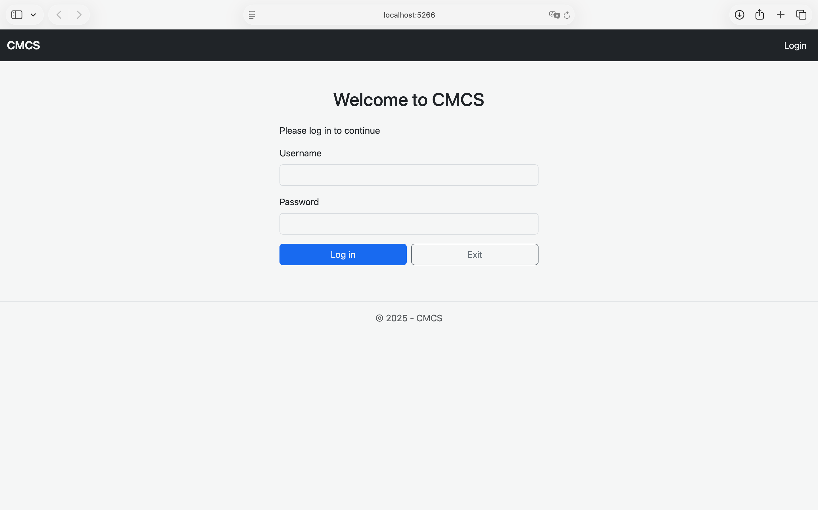
Log in
Welcome!

Slide 3
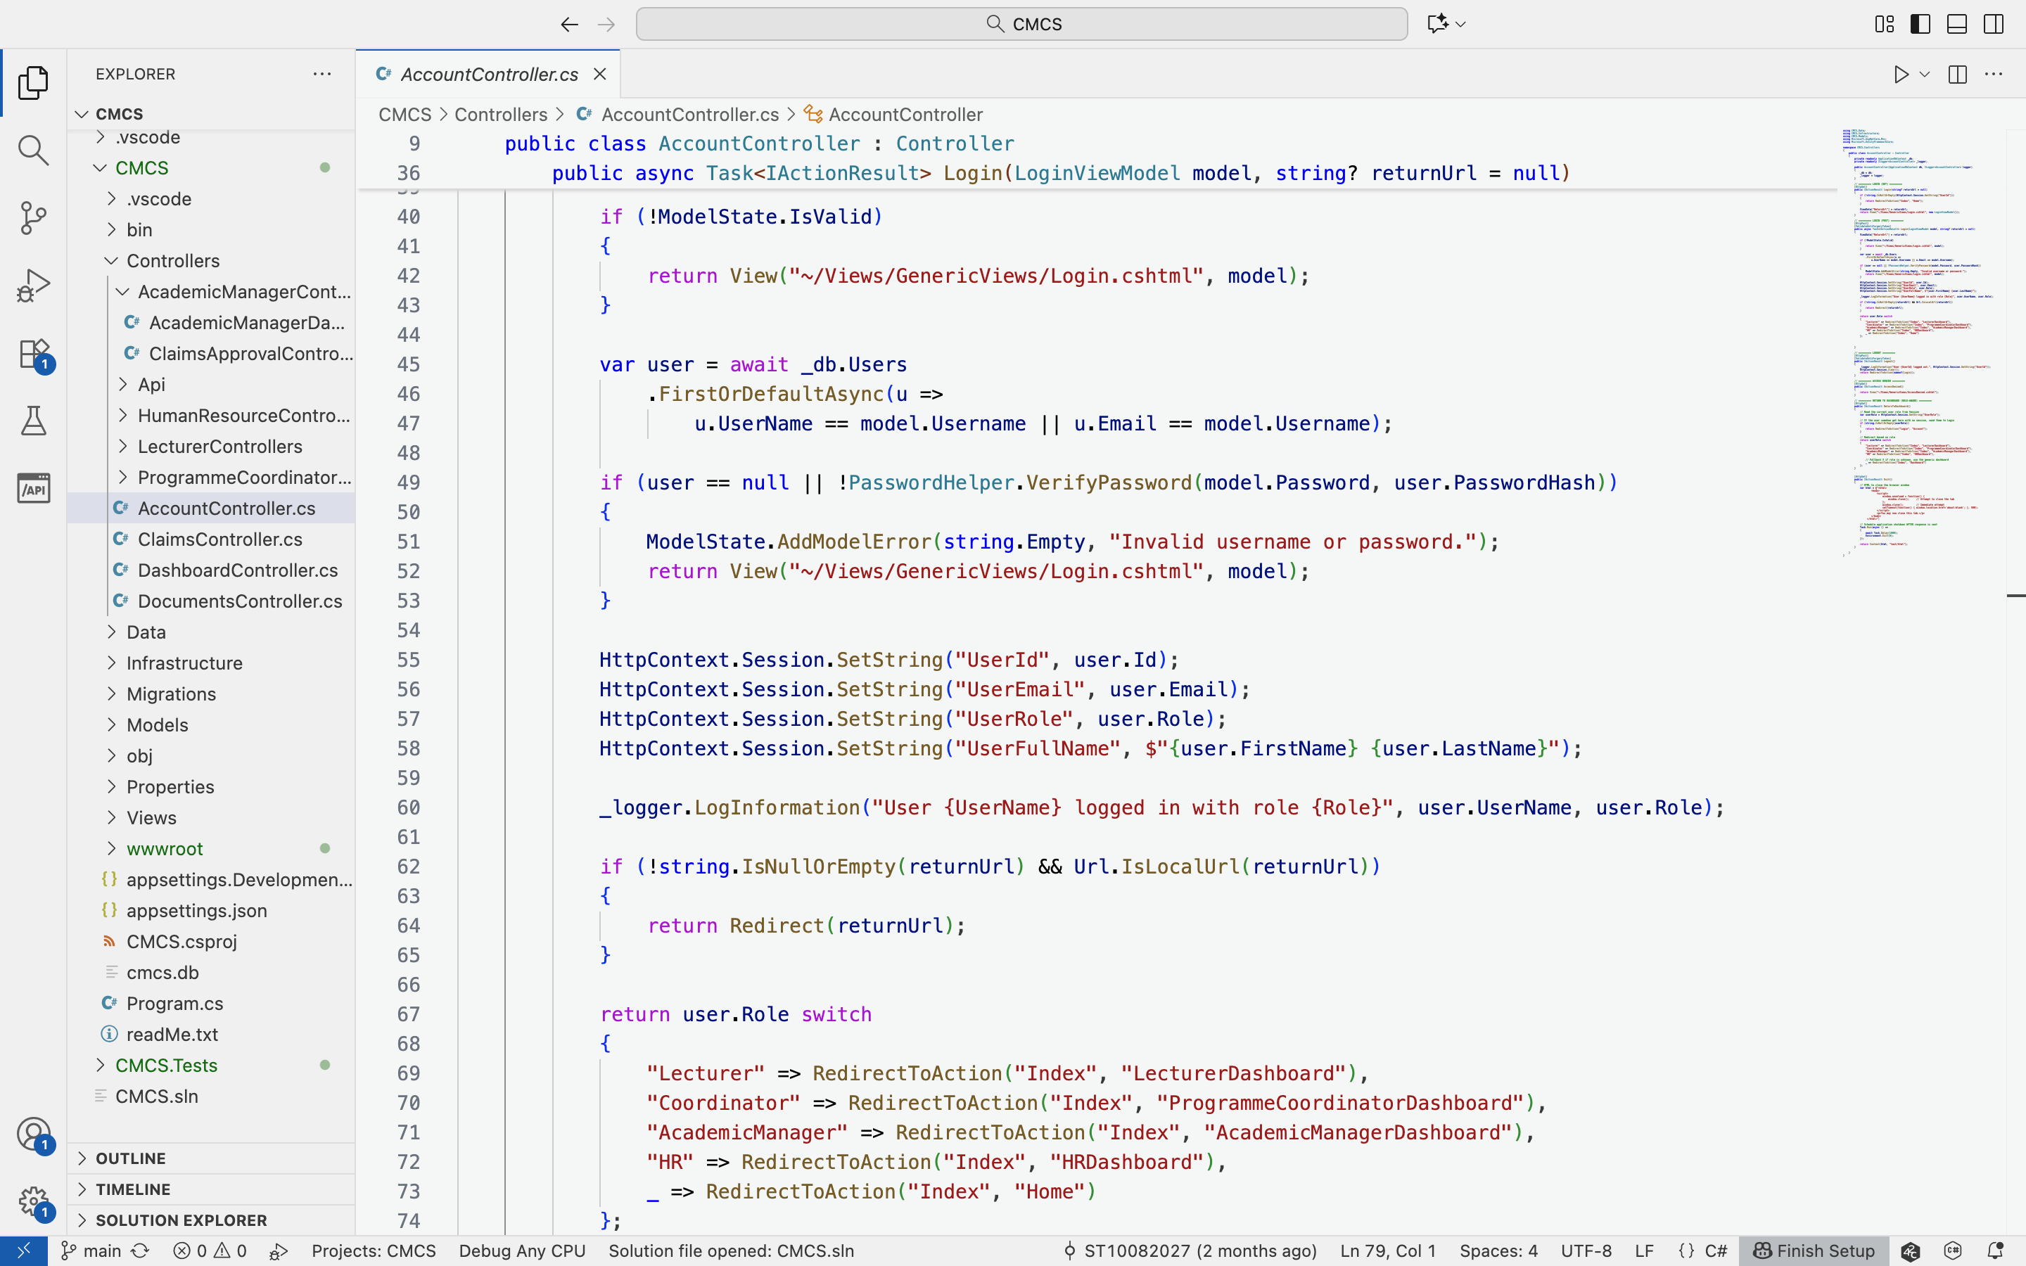
Log in: Code
Secure, session-driven authentication with intelligent role-specific dashboard redirection

Slide 4
lecturer
Submit monthly claims with documentation.
Enter hours and review calculations.
Track claim status through workflow.
View history of submitted claims.

Slide 5
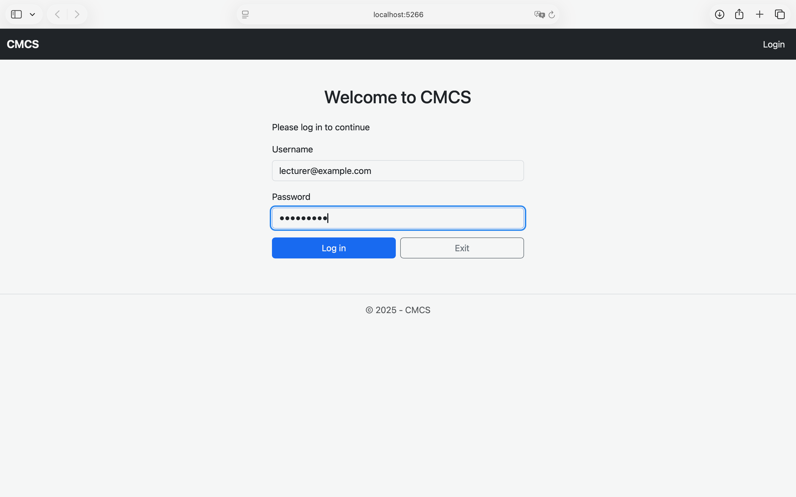
Lecturer: Log in
Utilises ASP.NET Sessions

Slide 6
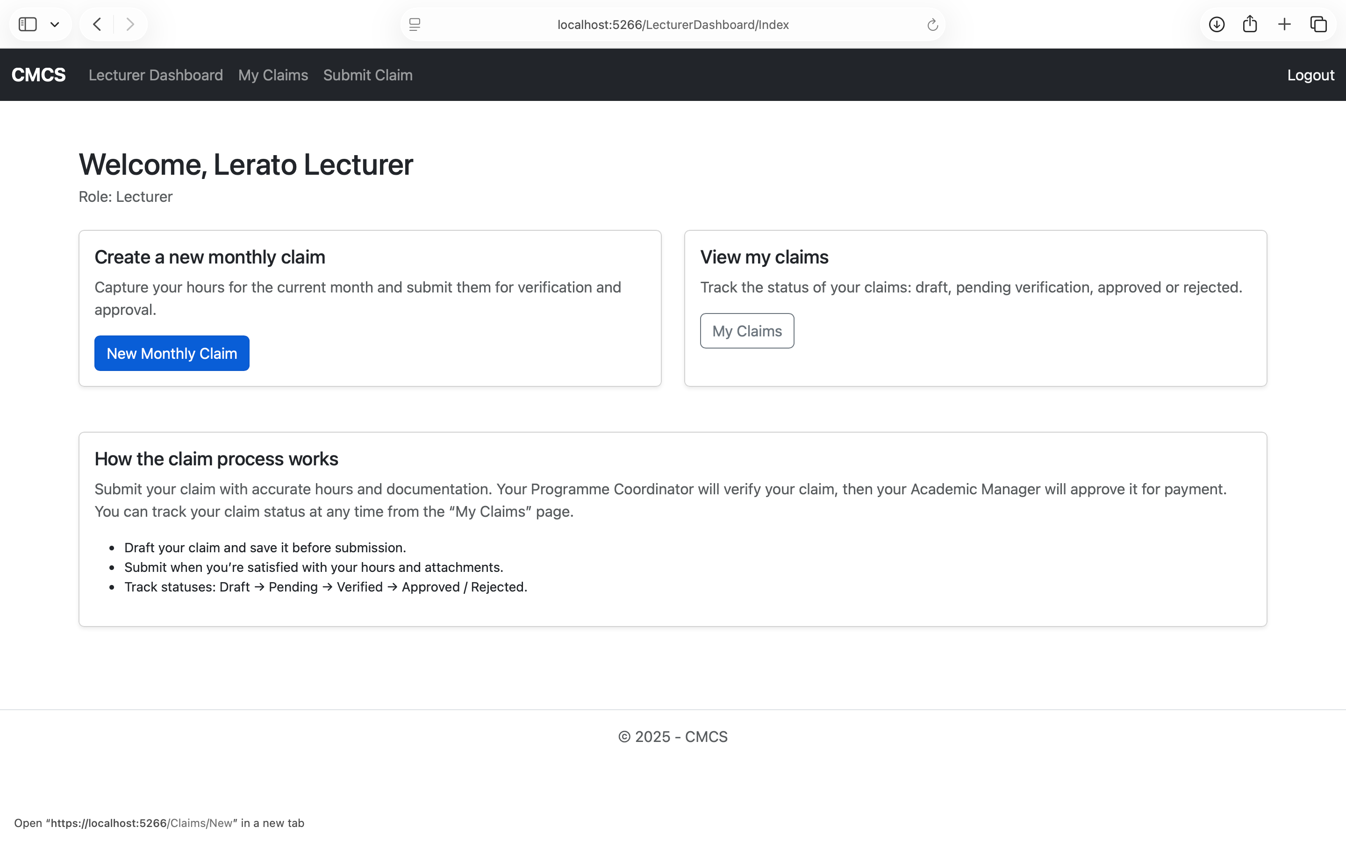
Lecturer: Dashboard
Create monthly claims

Slide 7
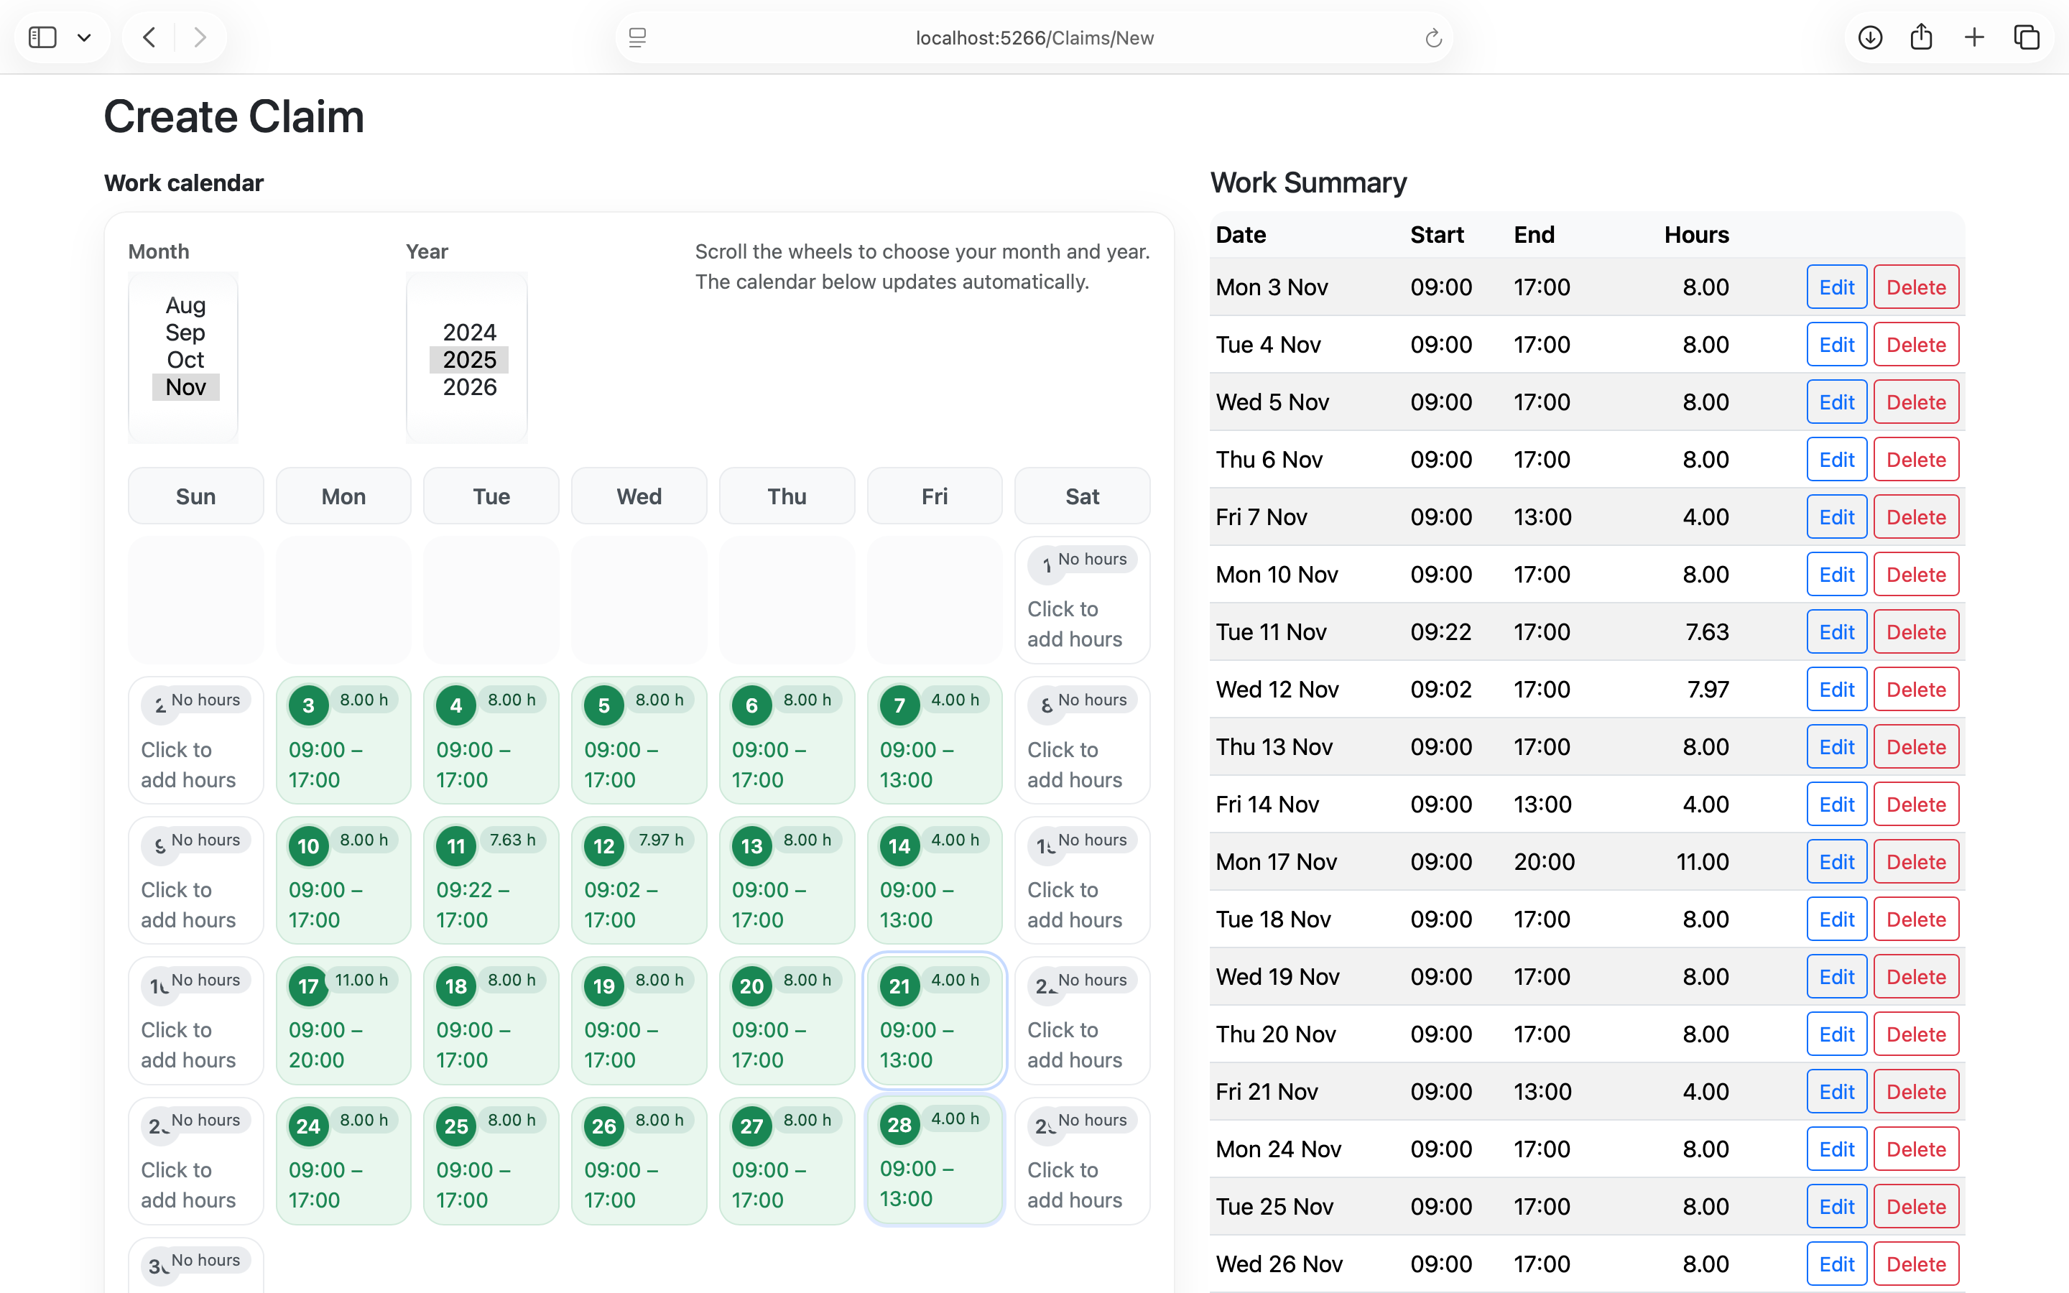
Lecturer: create claim
180 work hour monthly limits
Log hours worked

Slide 8
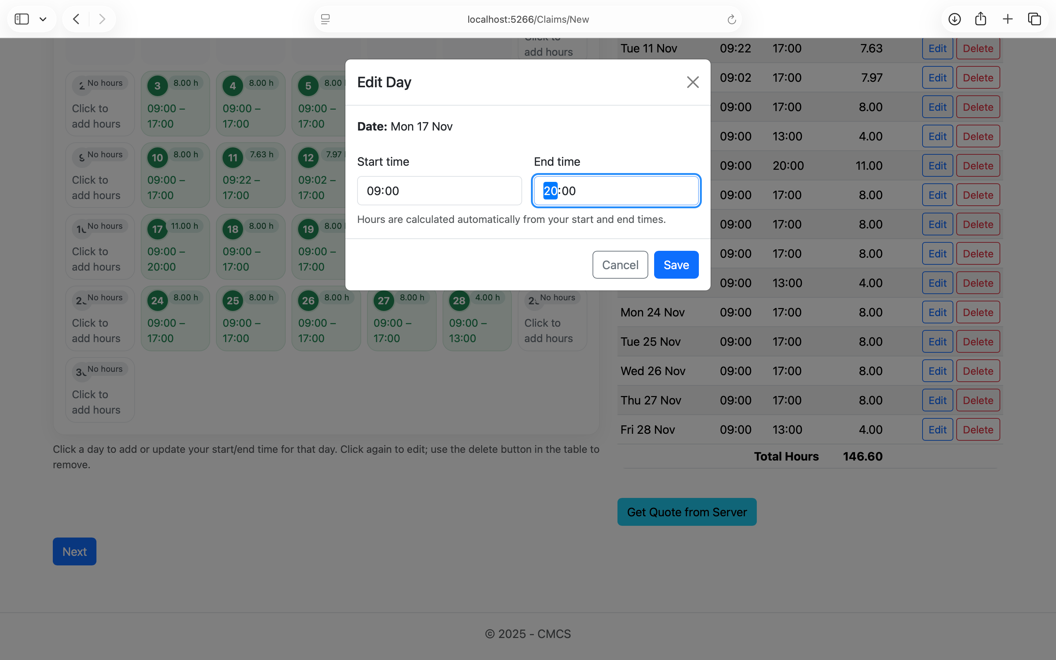
Lecturer: edit claim
Effortlessly edit hours

Slide 9
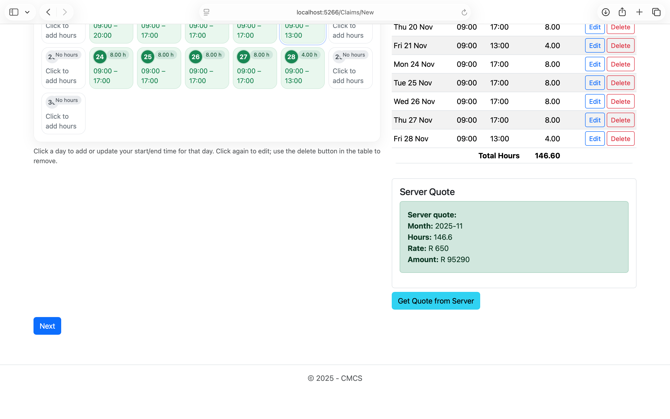
Lecturer: quote
Hourly rate is auto-pulled from Human Resources data
Auto-calculation using hours × hourly rate

Slide 10
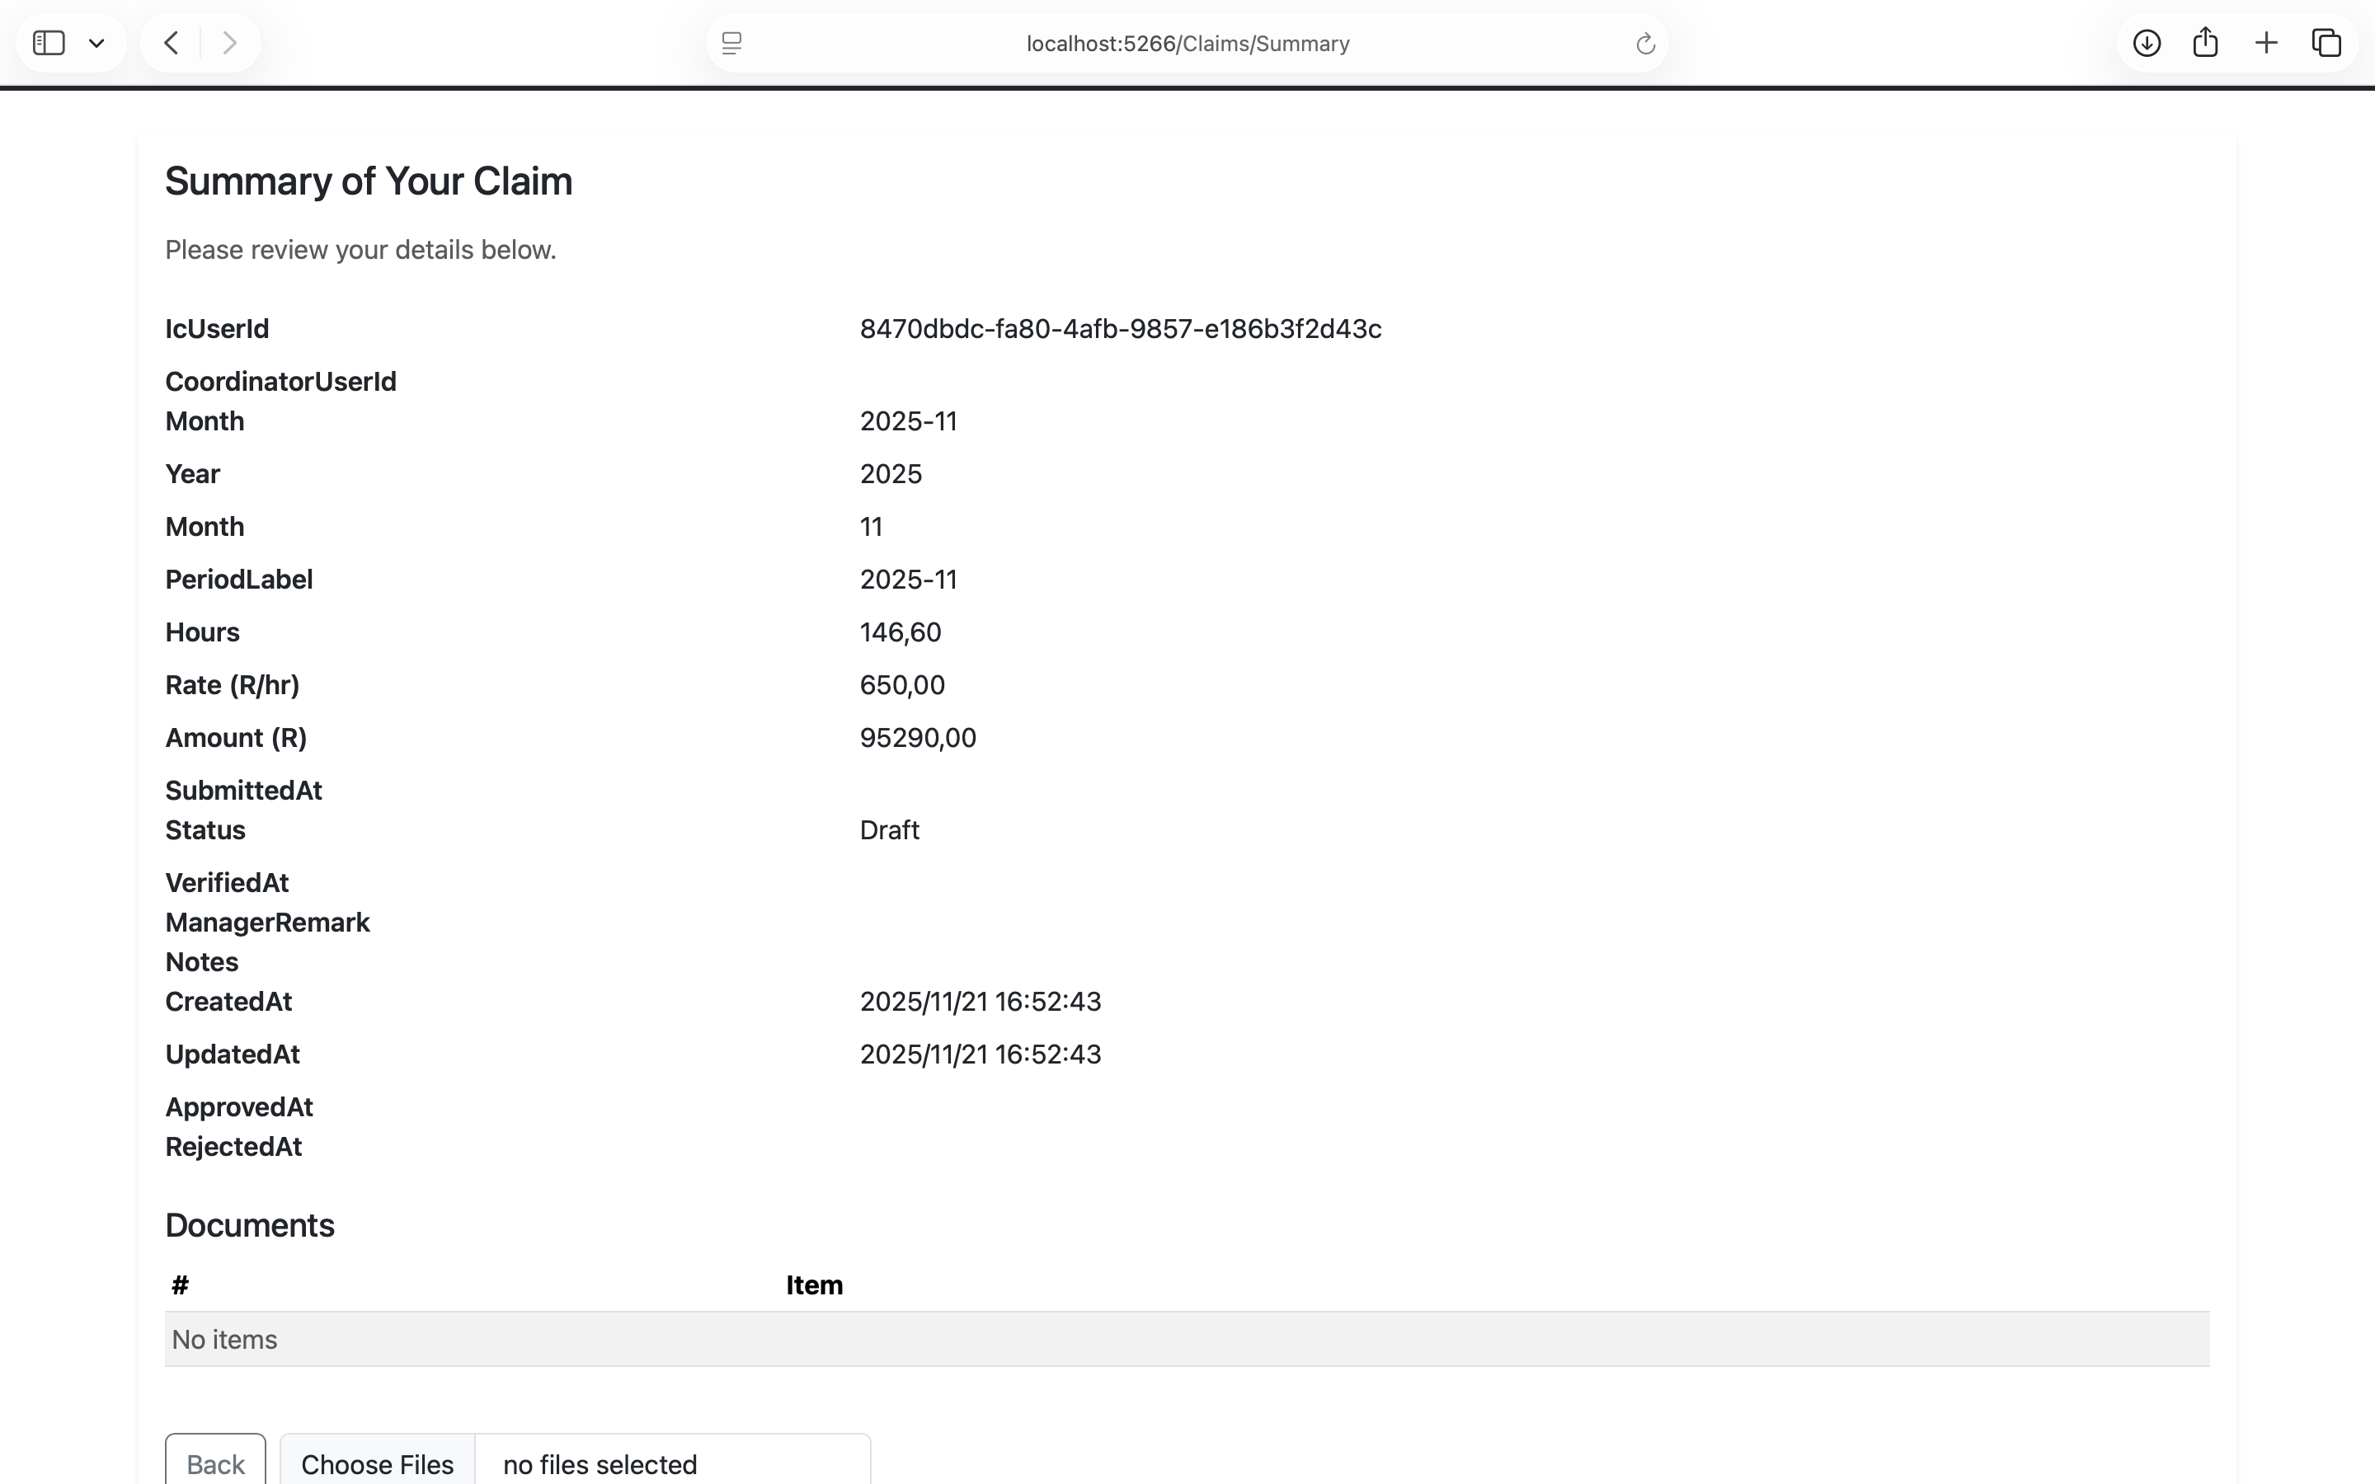
Lecturer: summary of claim

Slide 11
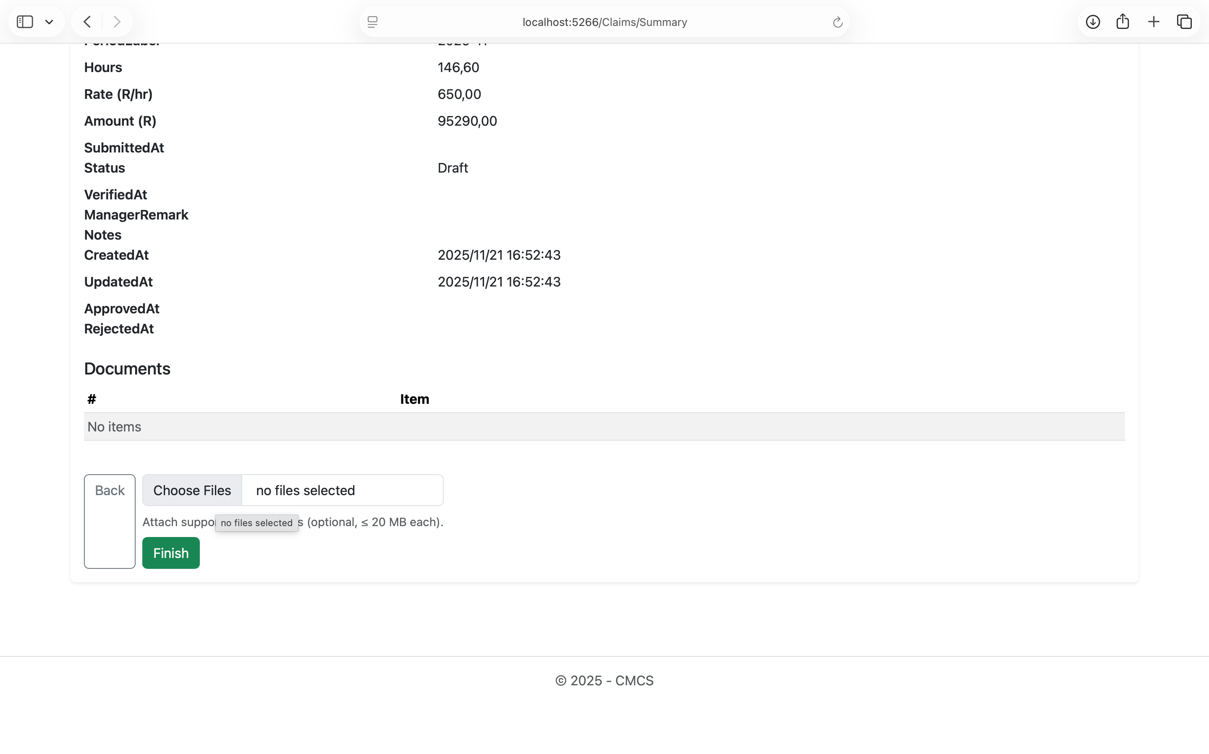
Lecturer: add supporting documents
Upload supporting documents like PDFs, PNGs and JPEGs

Slide 12
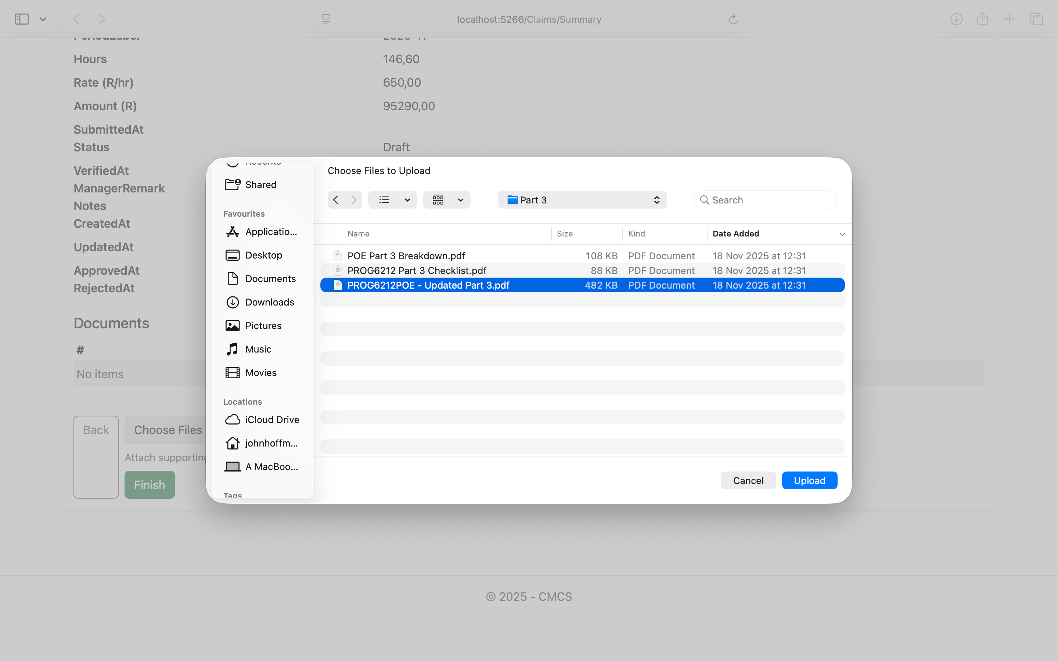
Lecturer: upload supporting documents

Slide 13
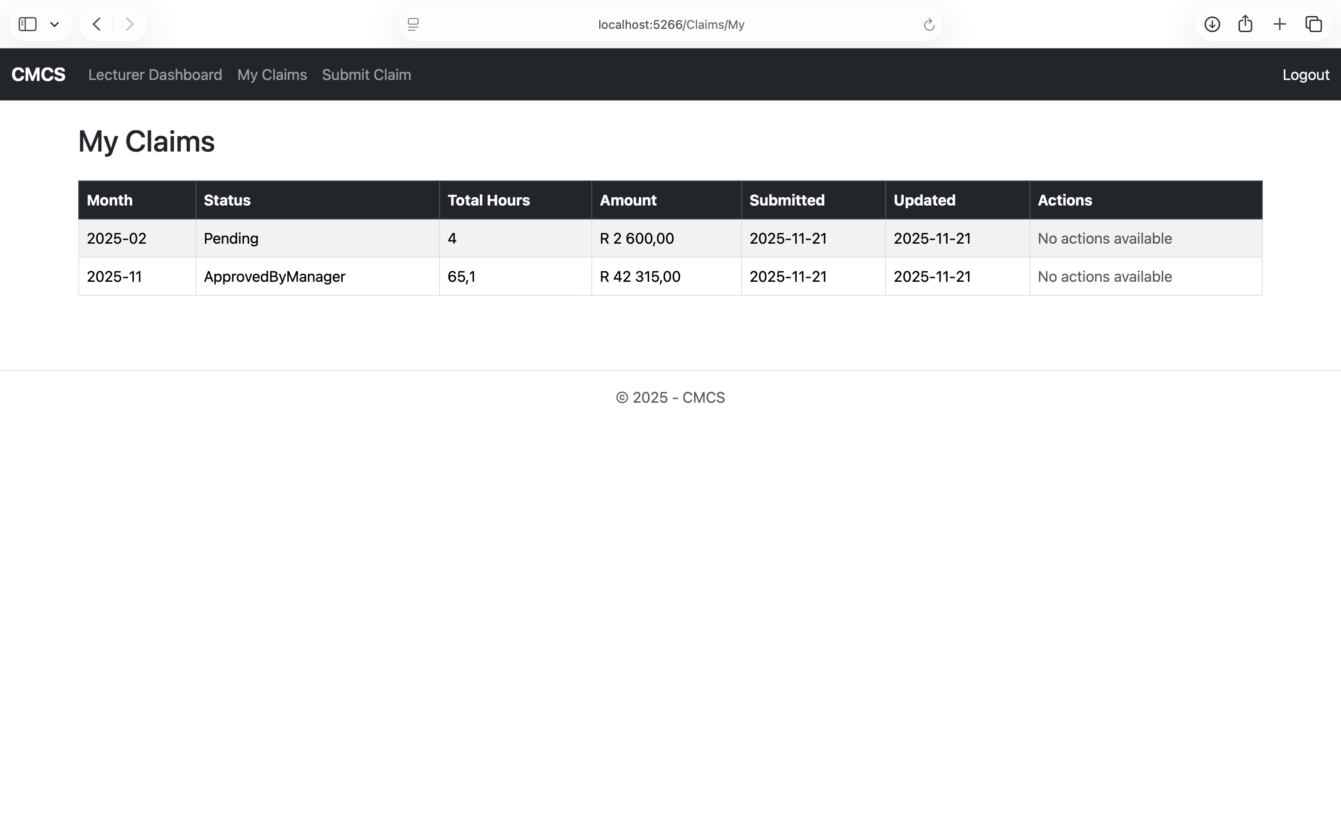
Lecturer: claims
Instant claim status updates through all stages

Slide 14
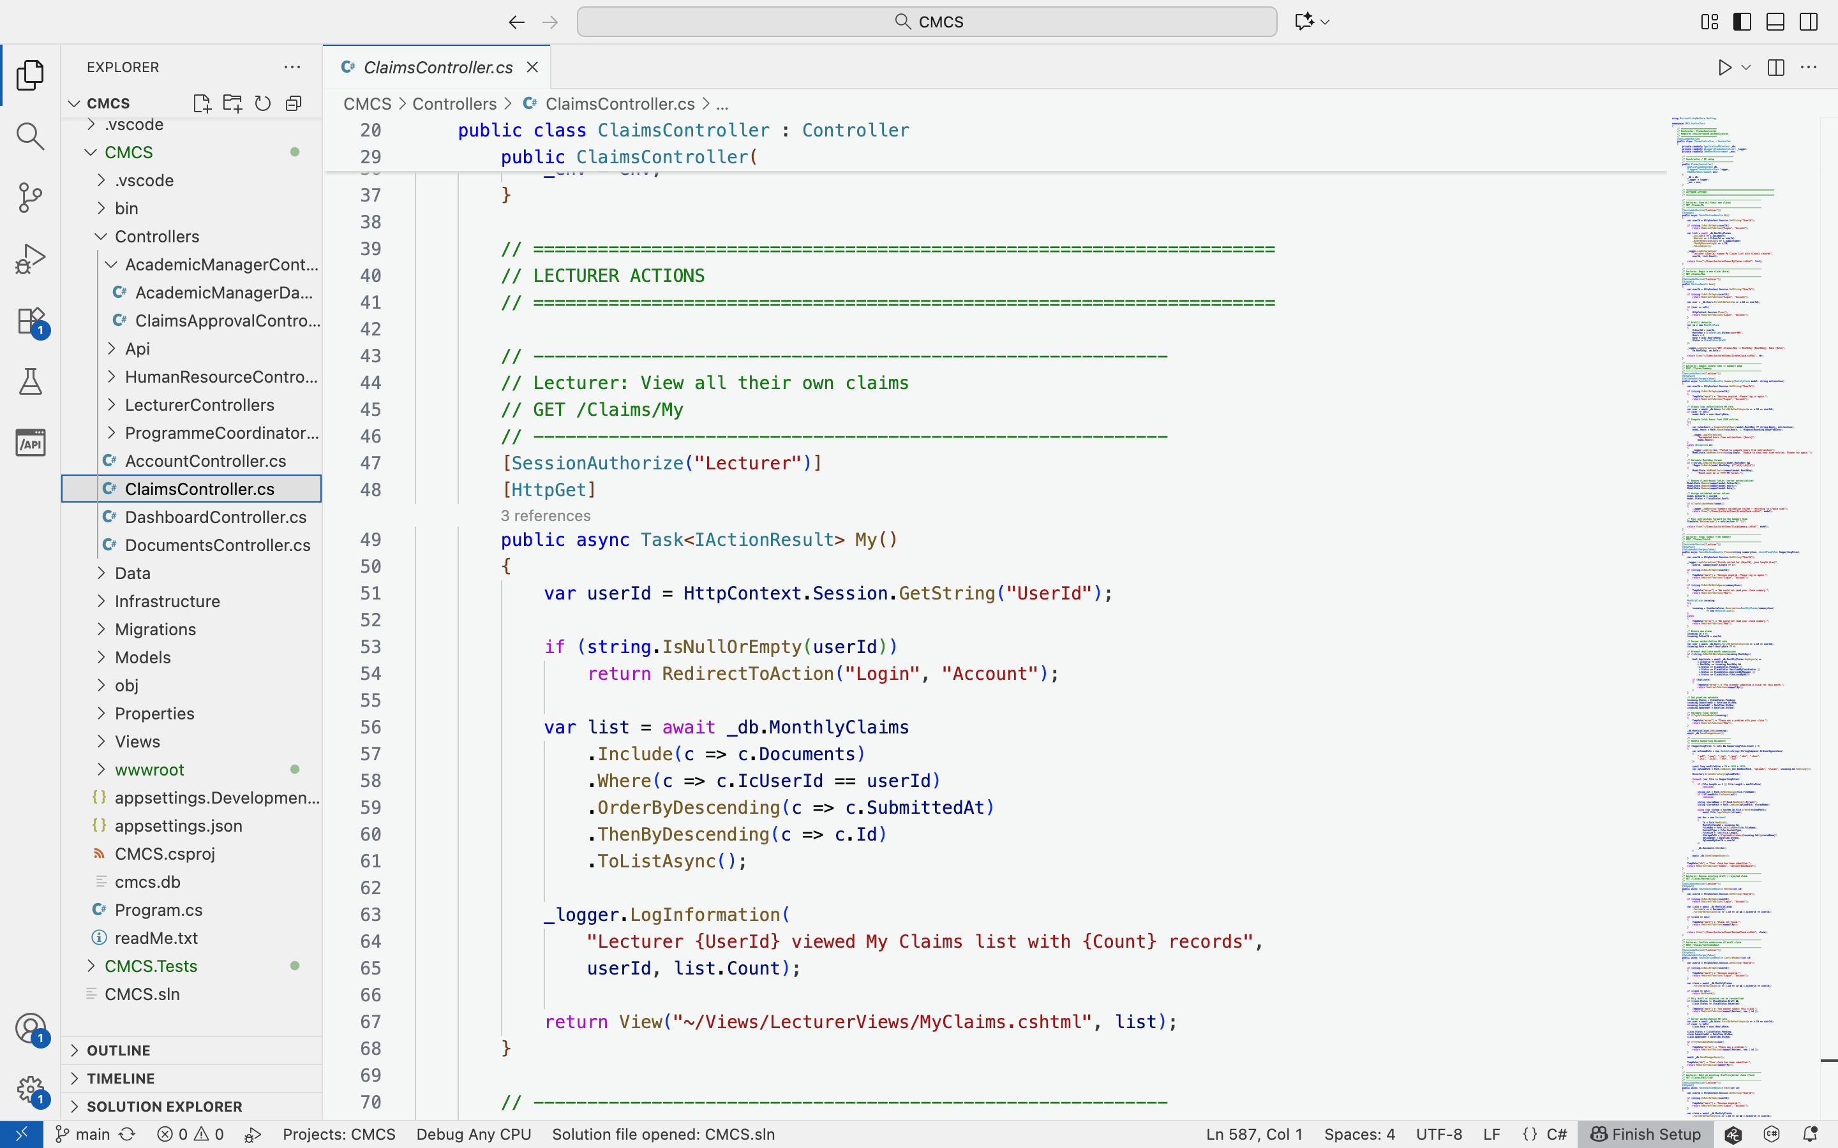
Lecturer: my claims code
Loads and displays lecturer specific claims

Slide 15
Programme coordinator
Review lecturer claims for accuracy.
Verify submitted hours and documents.
Forward valid claims for approval.

Slide 16
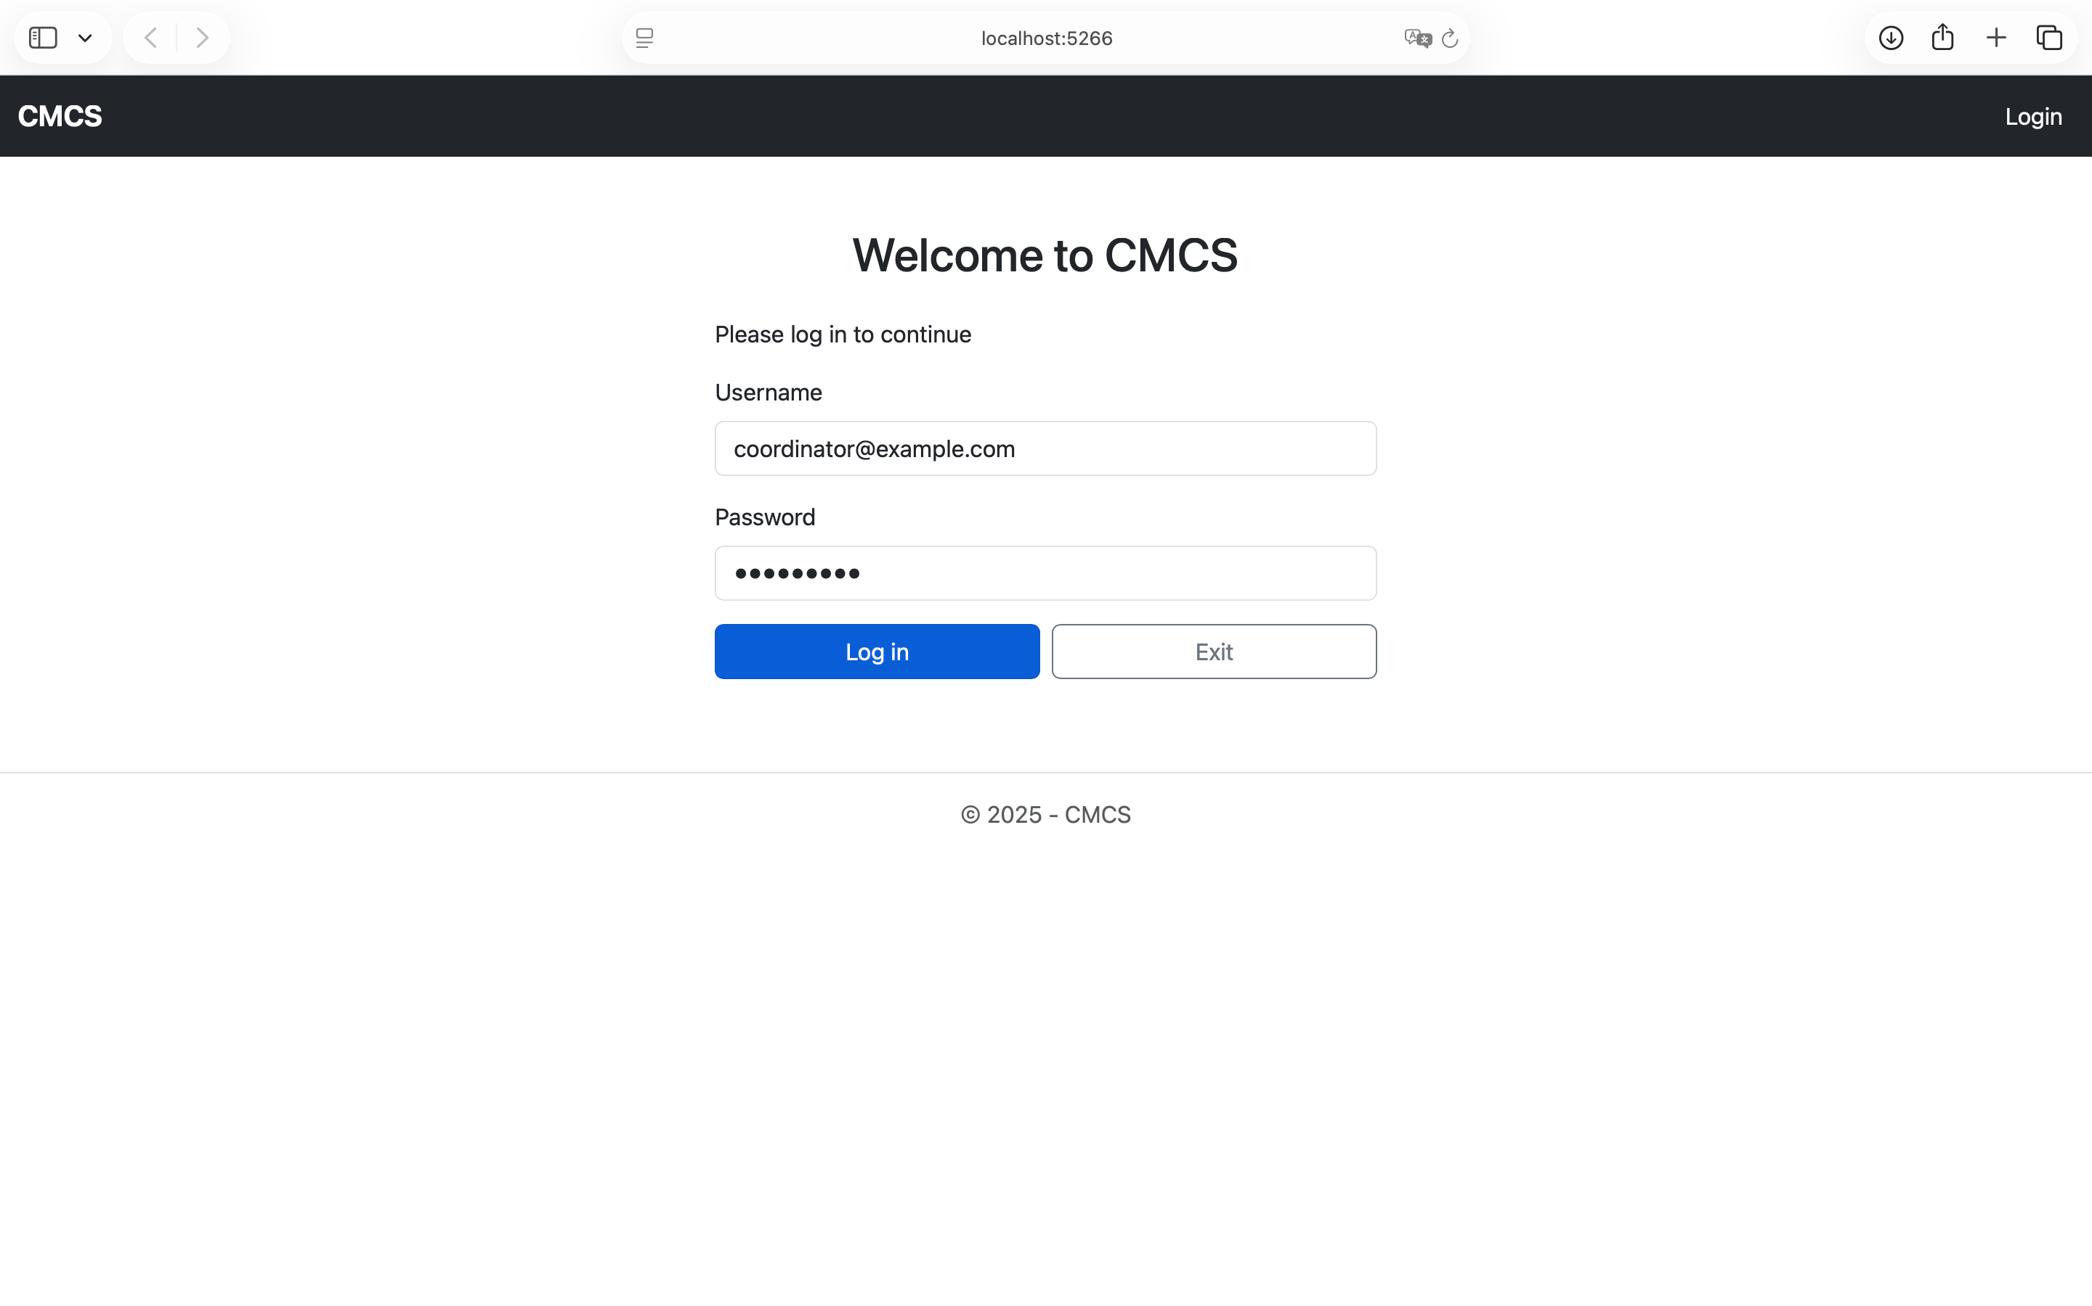
Programme coordinator: Log in
Utilises ASP.NET Sessions

Slide 17
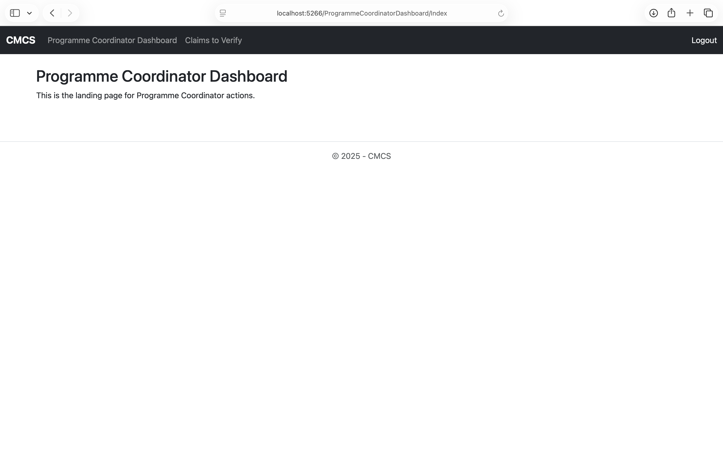
Programme coordinator: dashboard

Slide 18
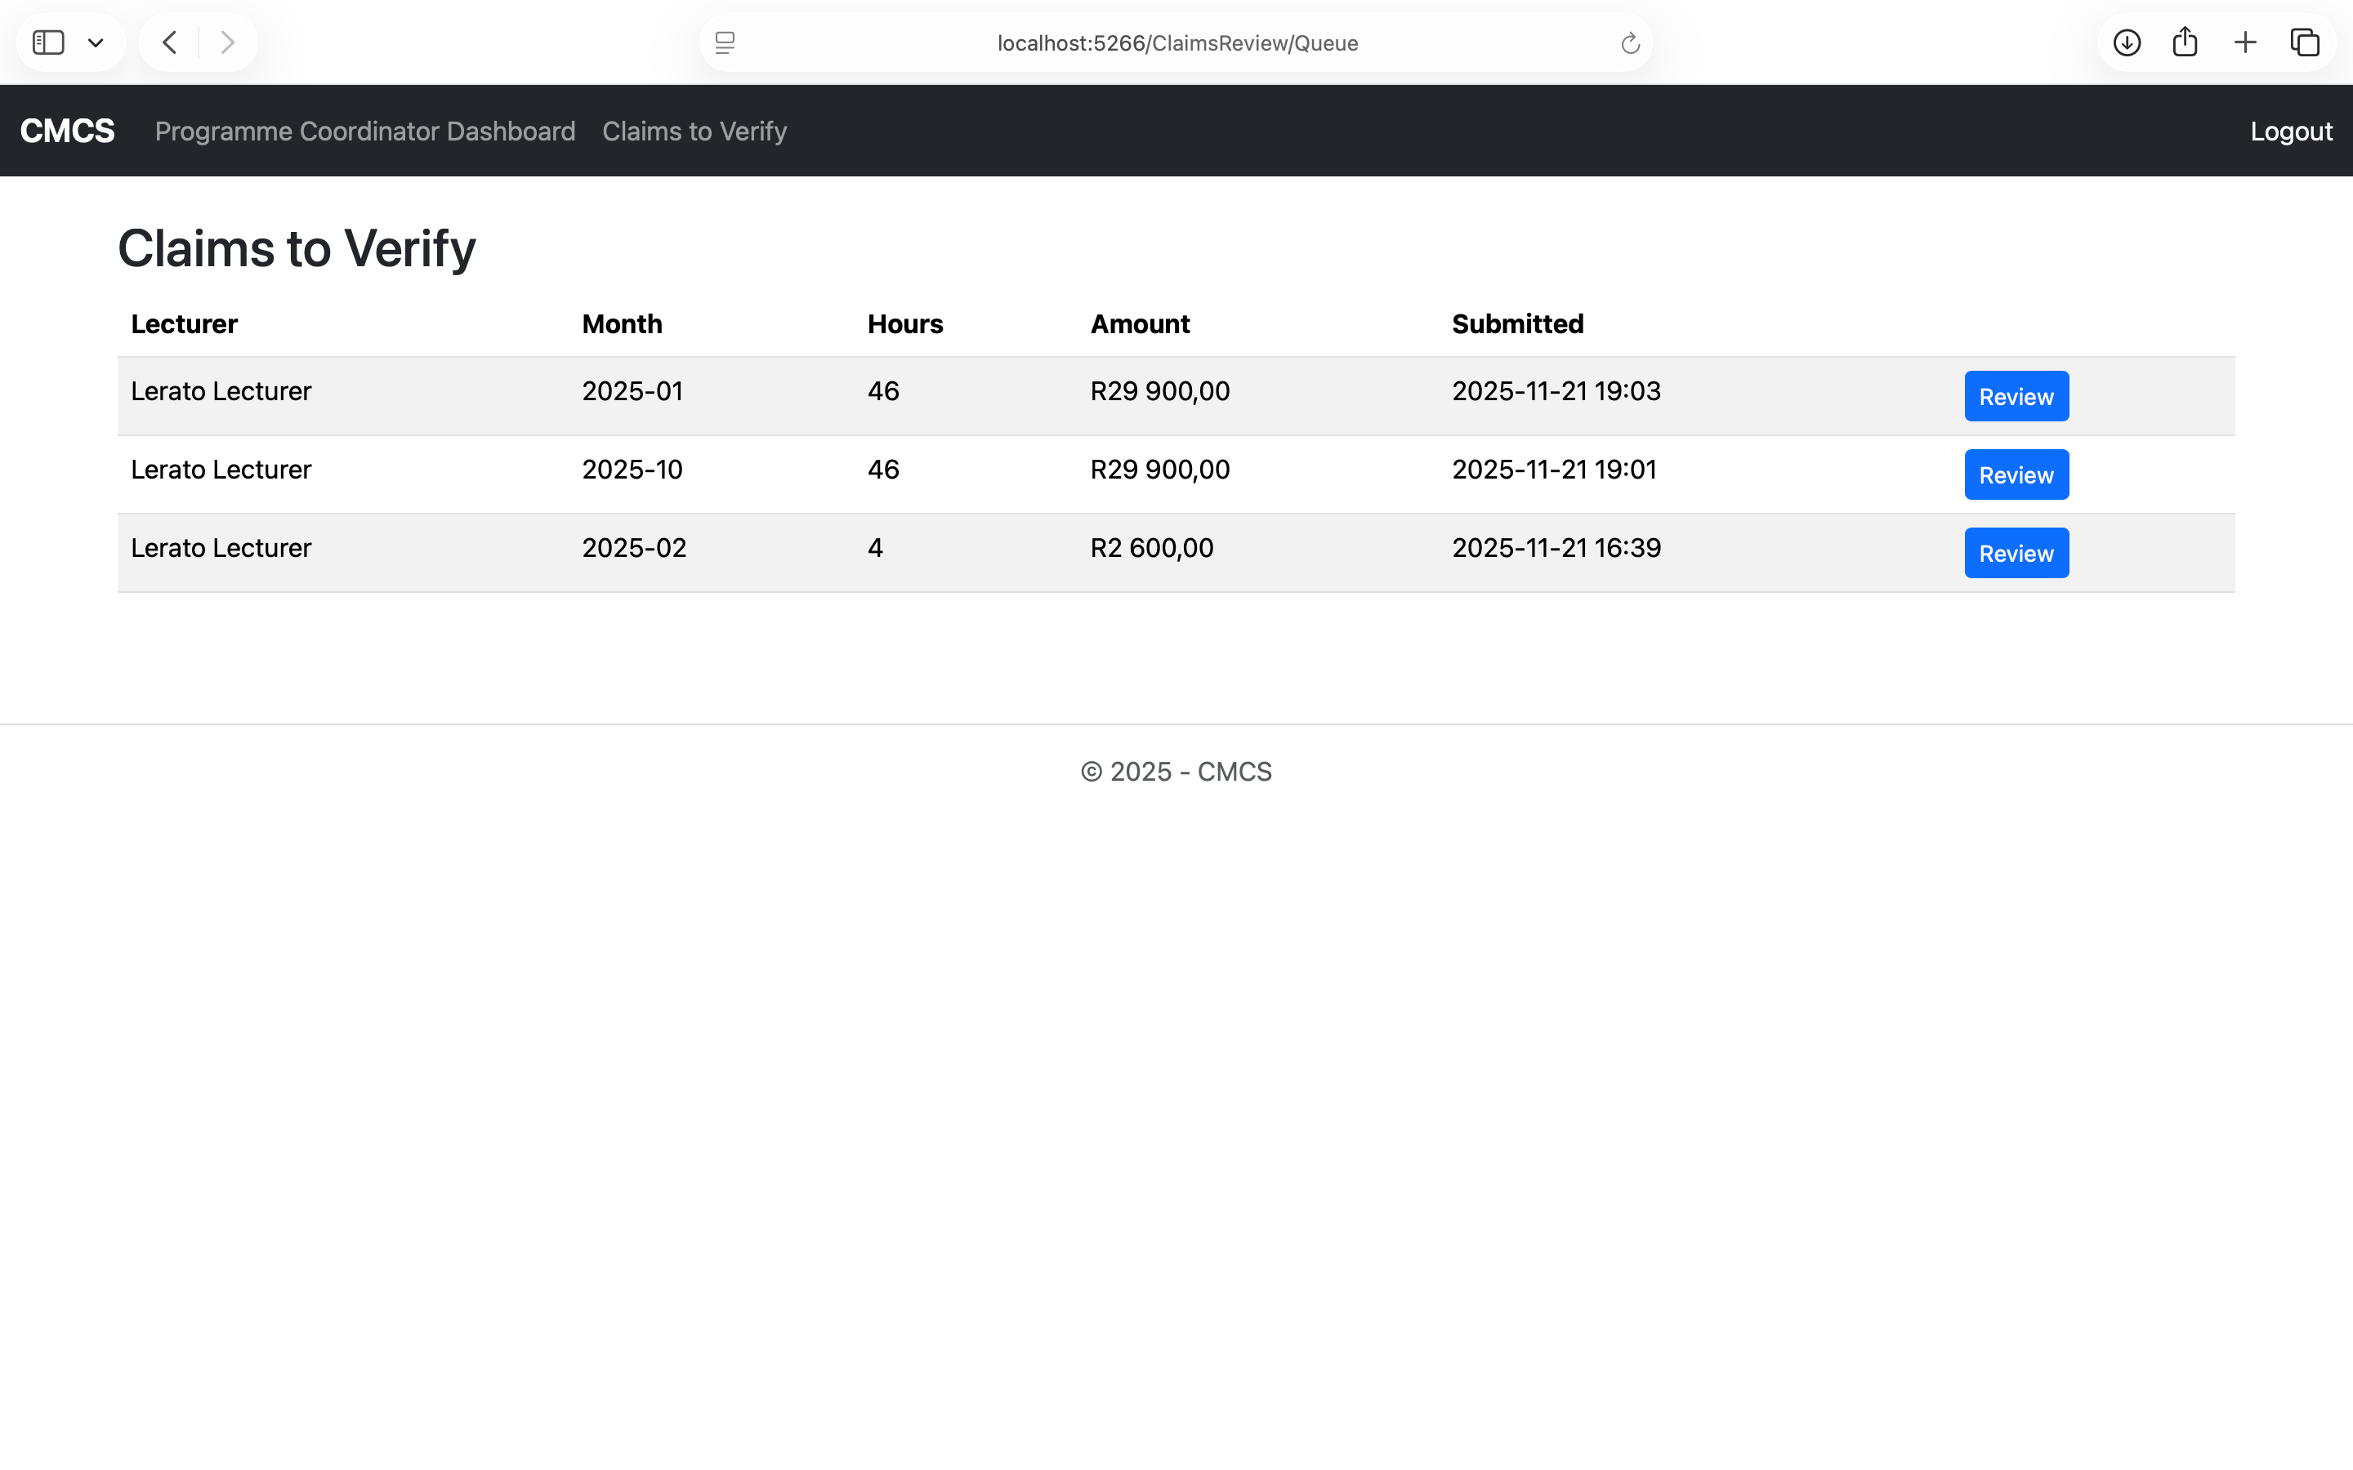
Programme coordinator: claims to verify
View all lecturer submitted claims awaiting verification

Slide 19
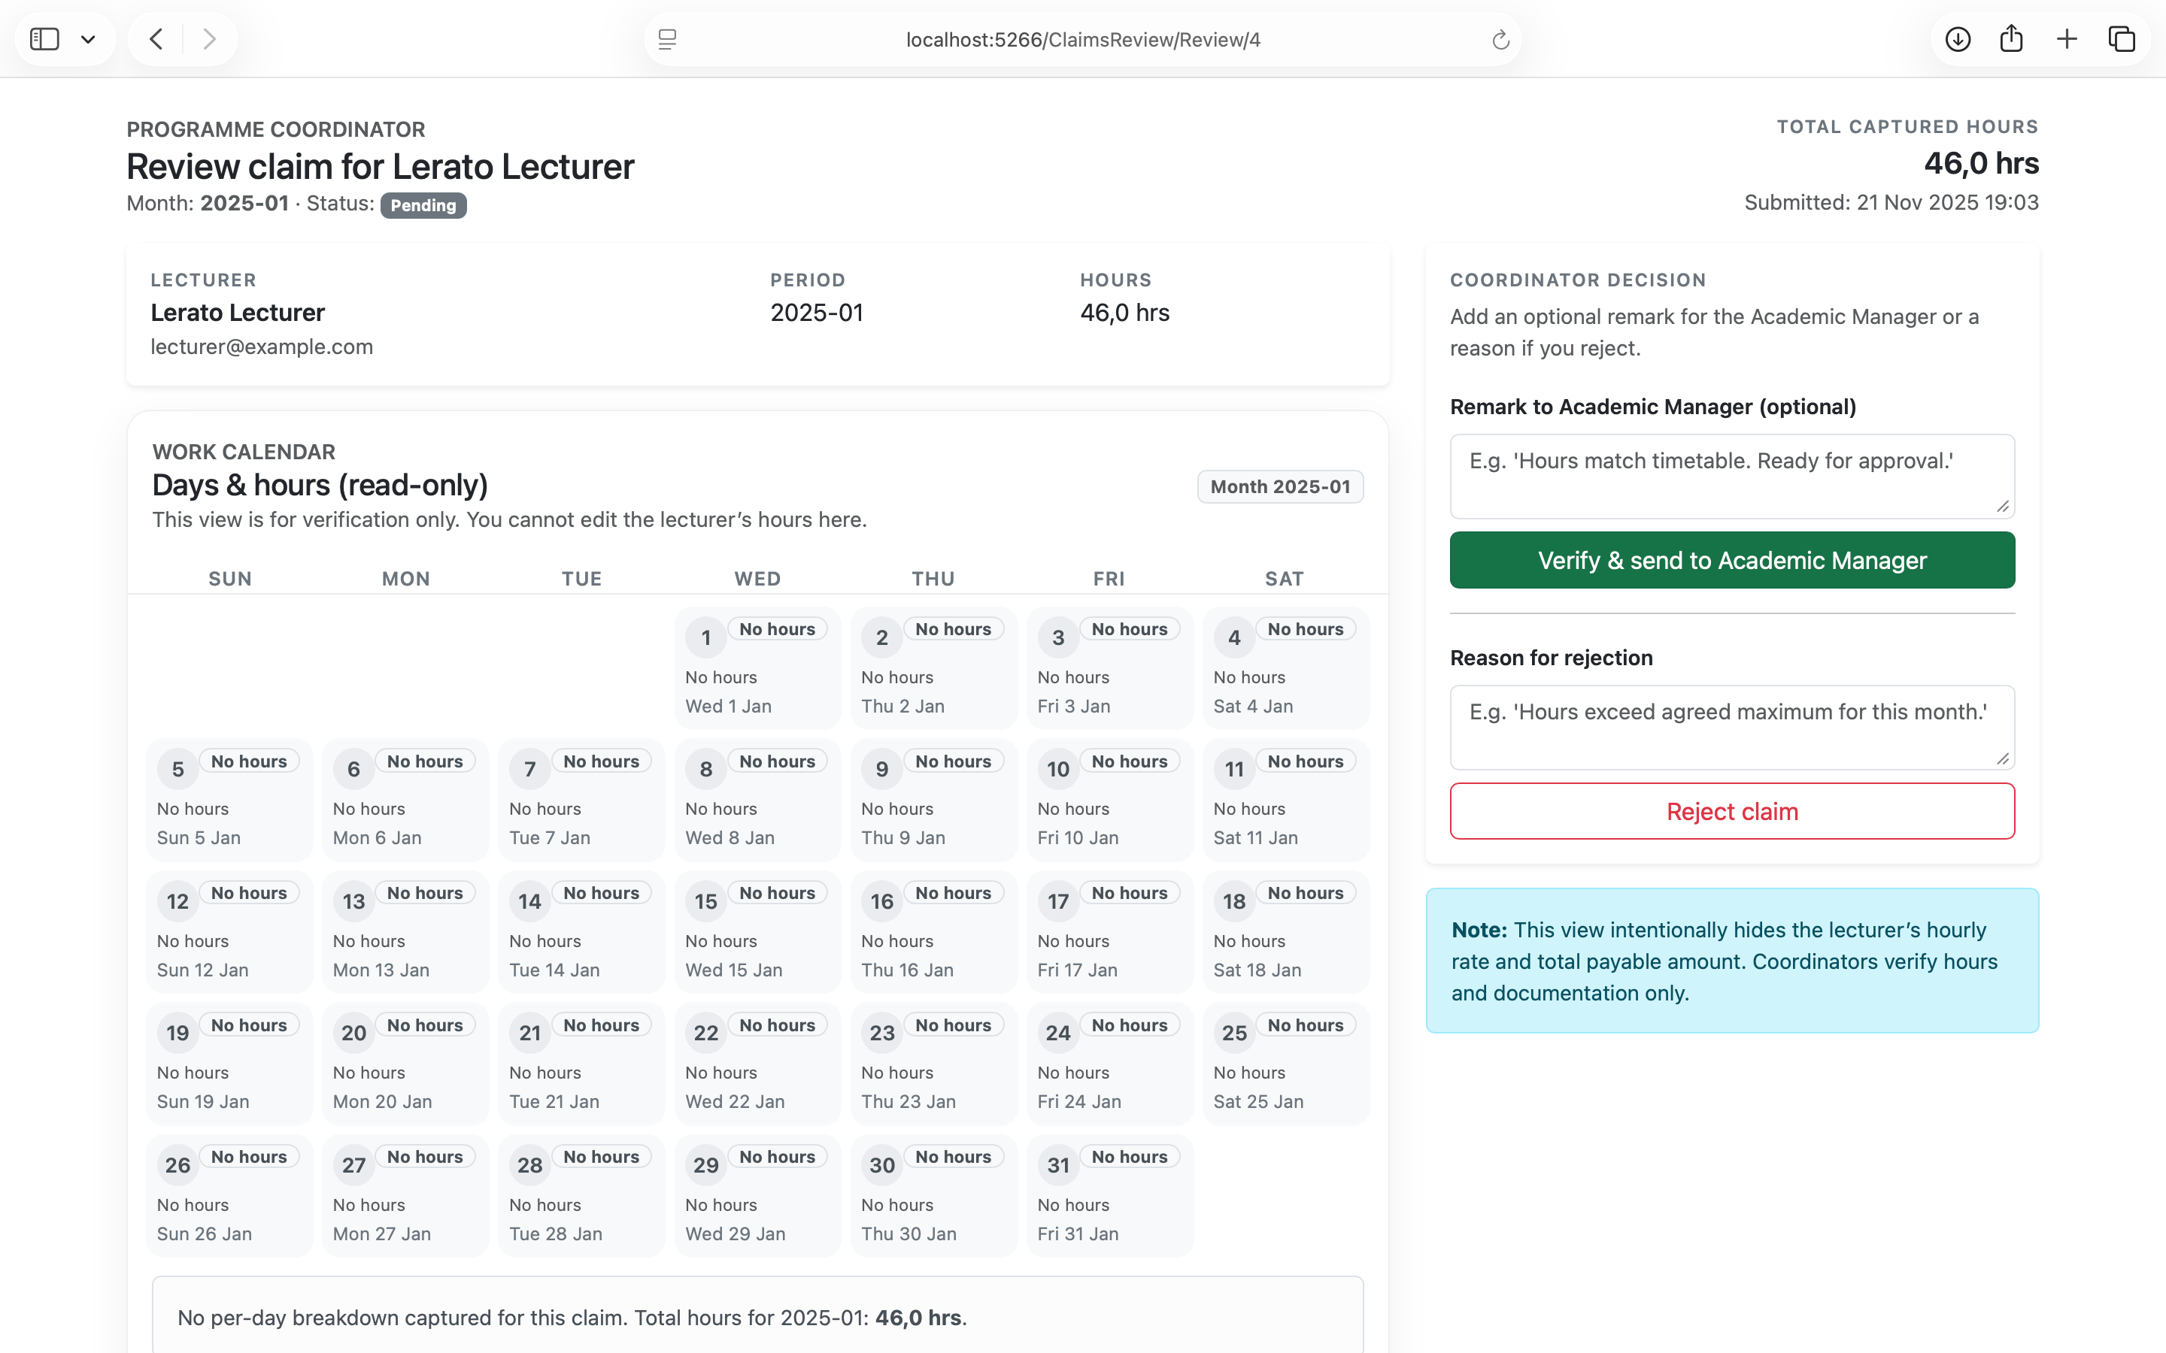
Programme coordinator: verify / reject claim
Approve or reject lecturer claims based on accuracy and completeness
Updates claim status

Slide 20
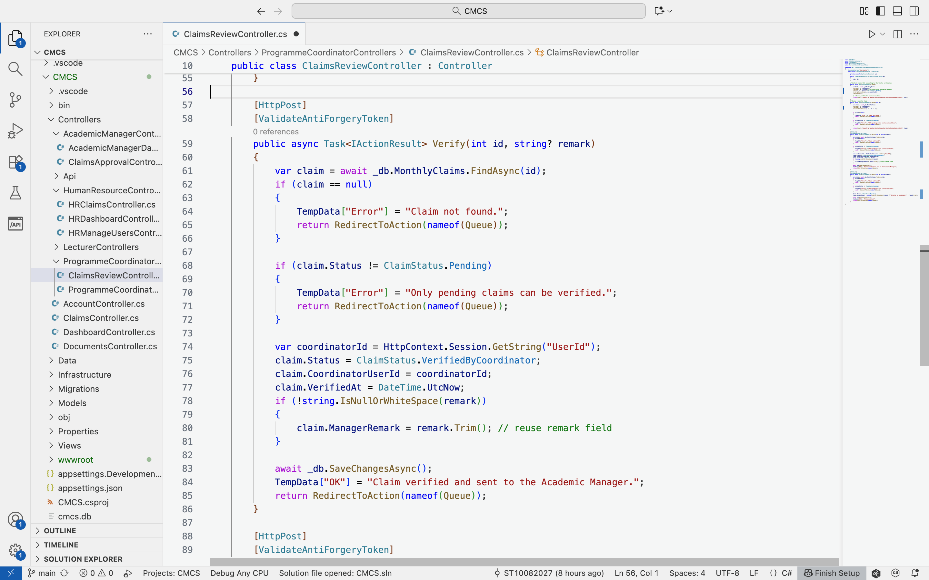
Programme coordinator: Verify claims Code

Slide 21
Academic manager
Approve coordinator-verified monthly claims.
Reject invalid claims with justification.
Ensure workflow integrity and compliance.
Authorize claims for HR processing.

Slide 22
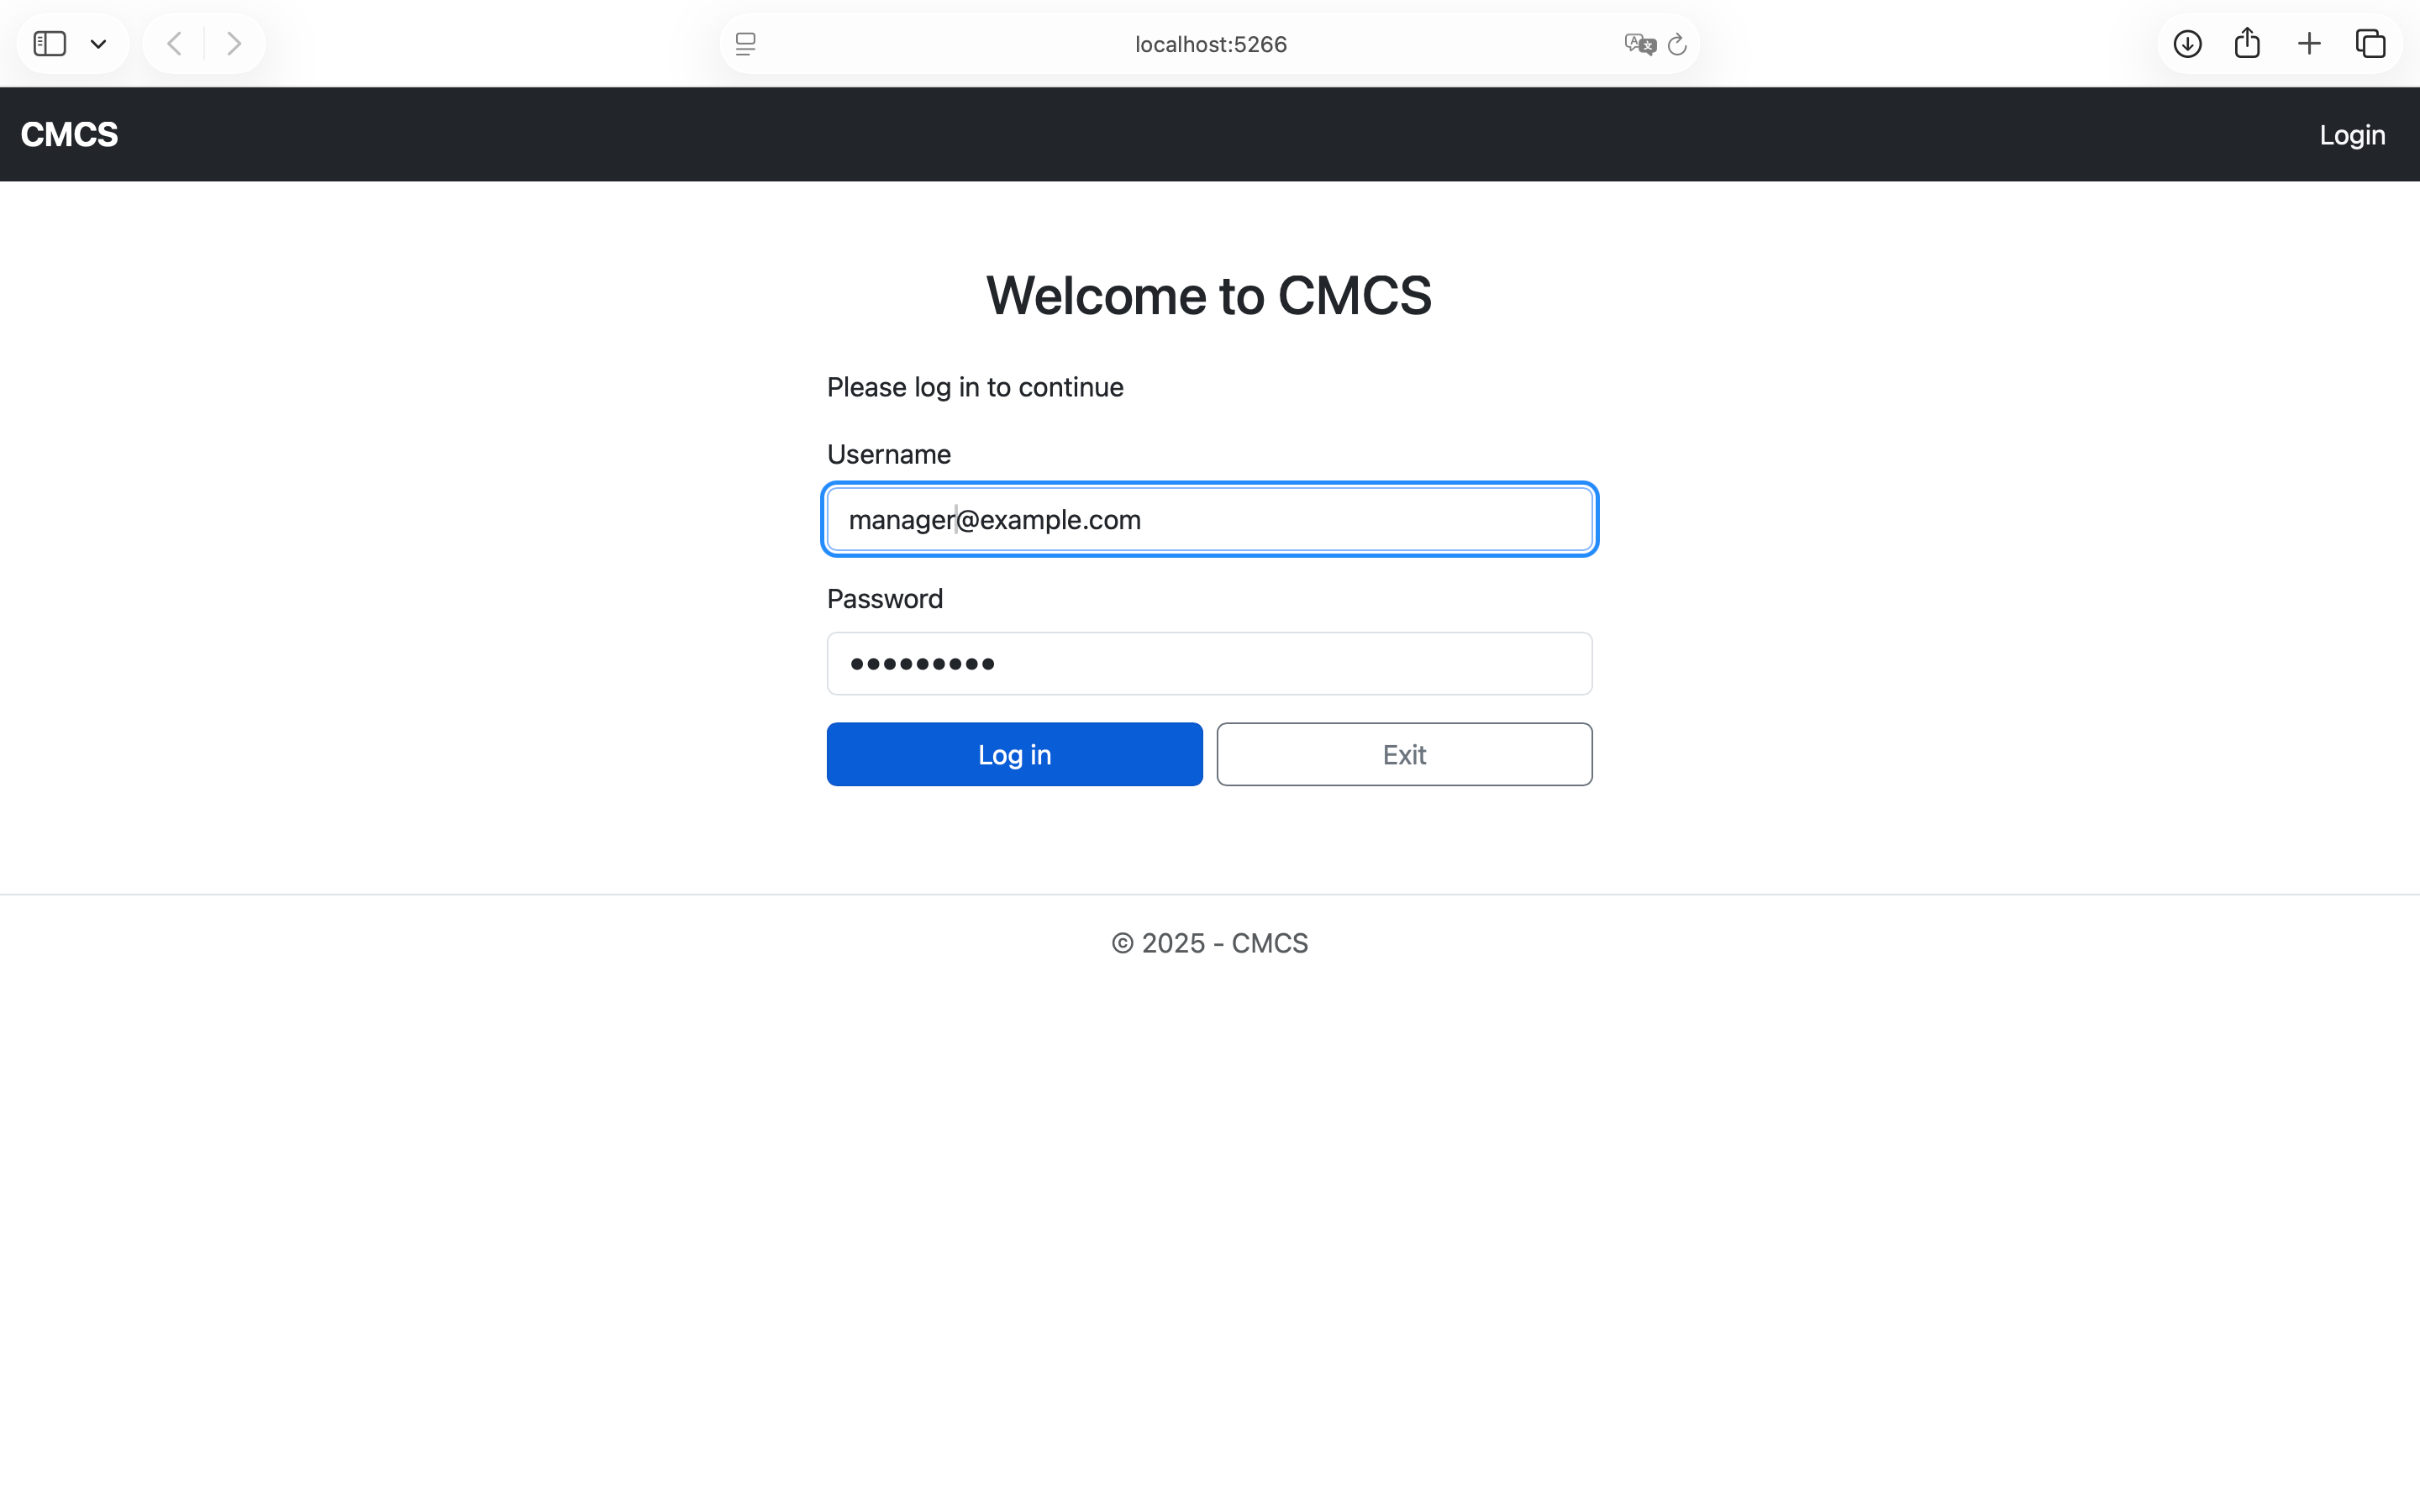
Academic manager: Log in
Utilises ASP.NET Sessions

Slide 23
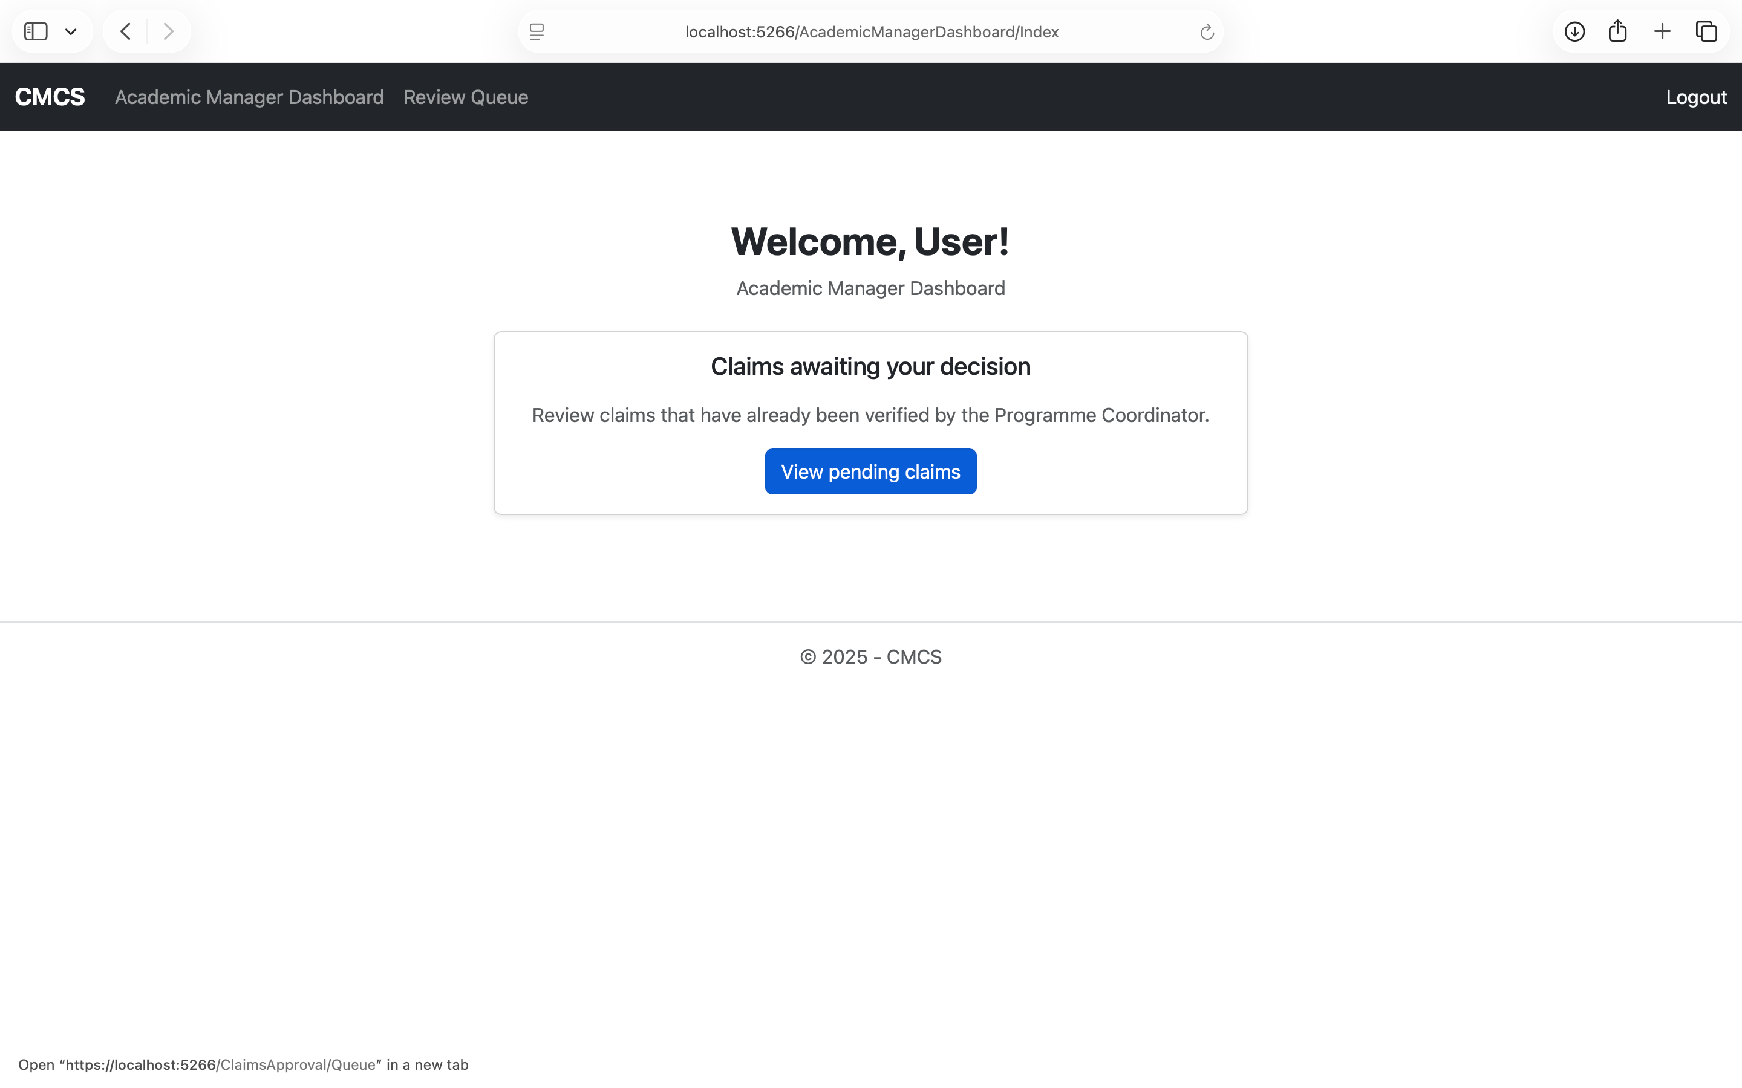
Academic manager: dashboard

Slide 24
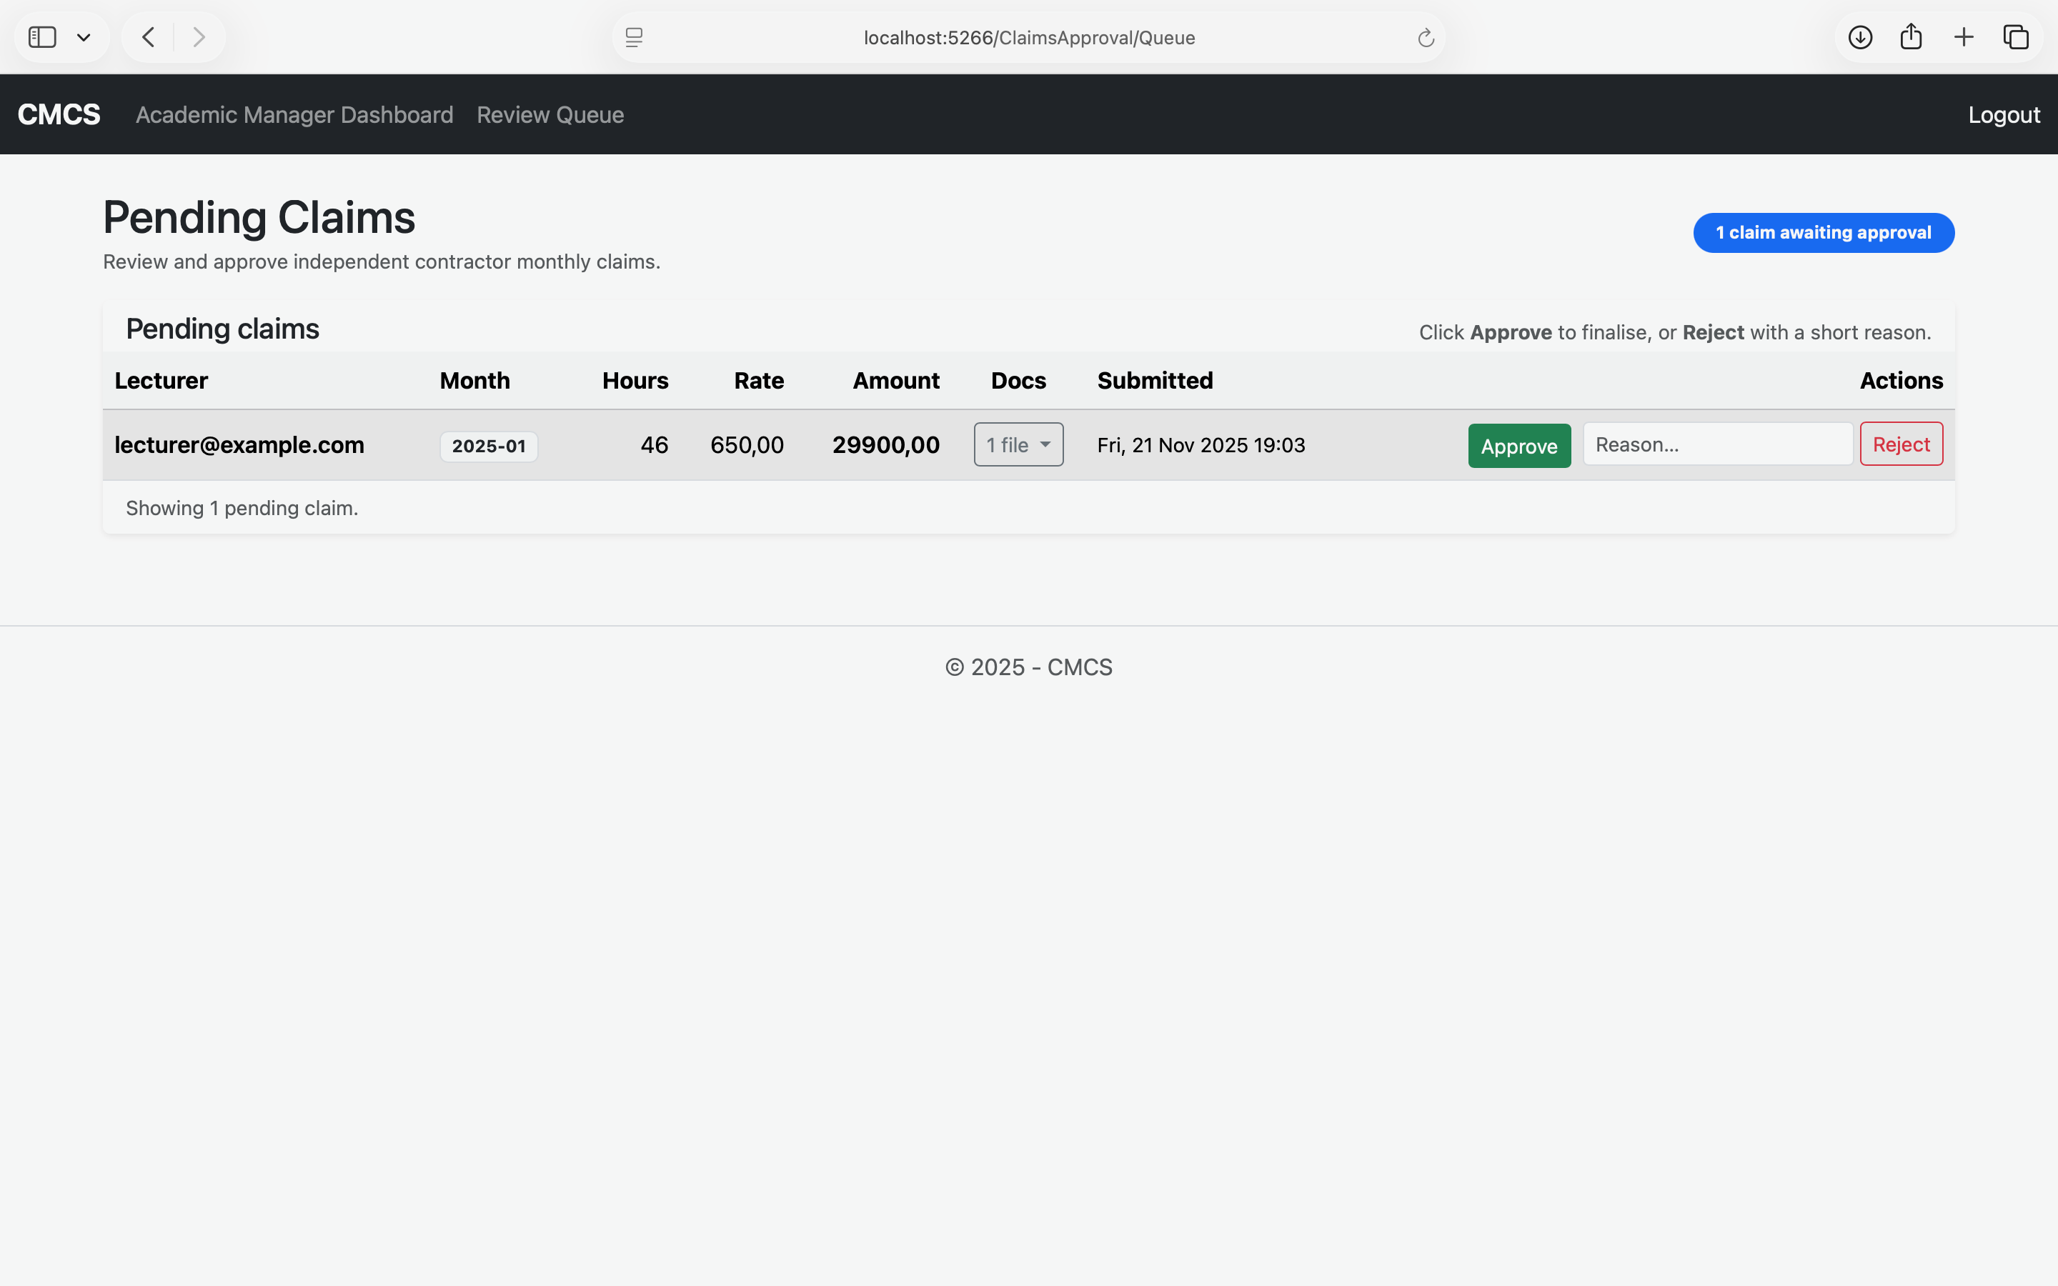
Academic manager: pending claims
Actions trigger status updates visible
Approve or reject claims

Slide 25
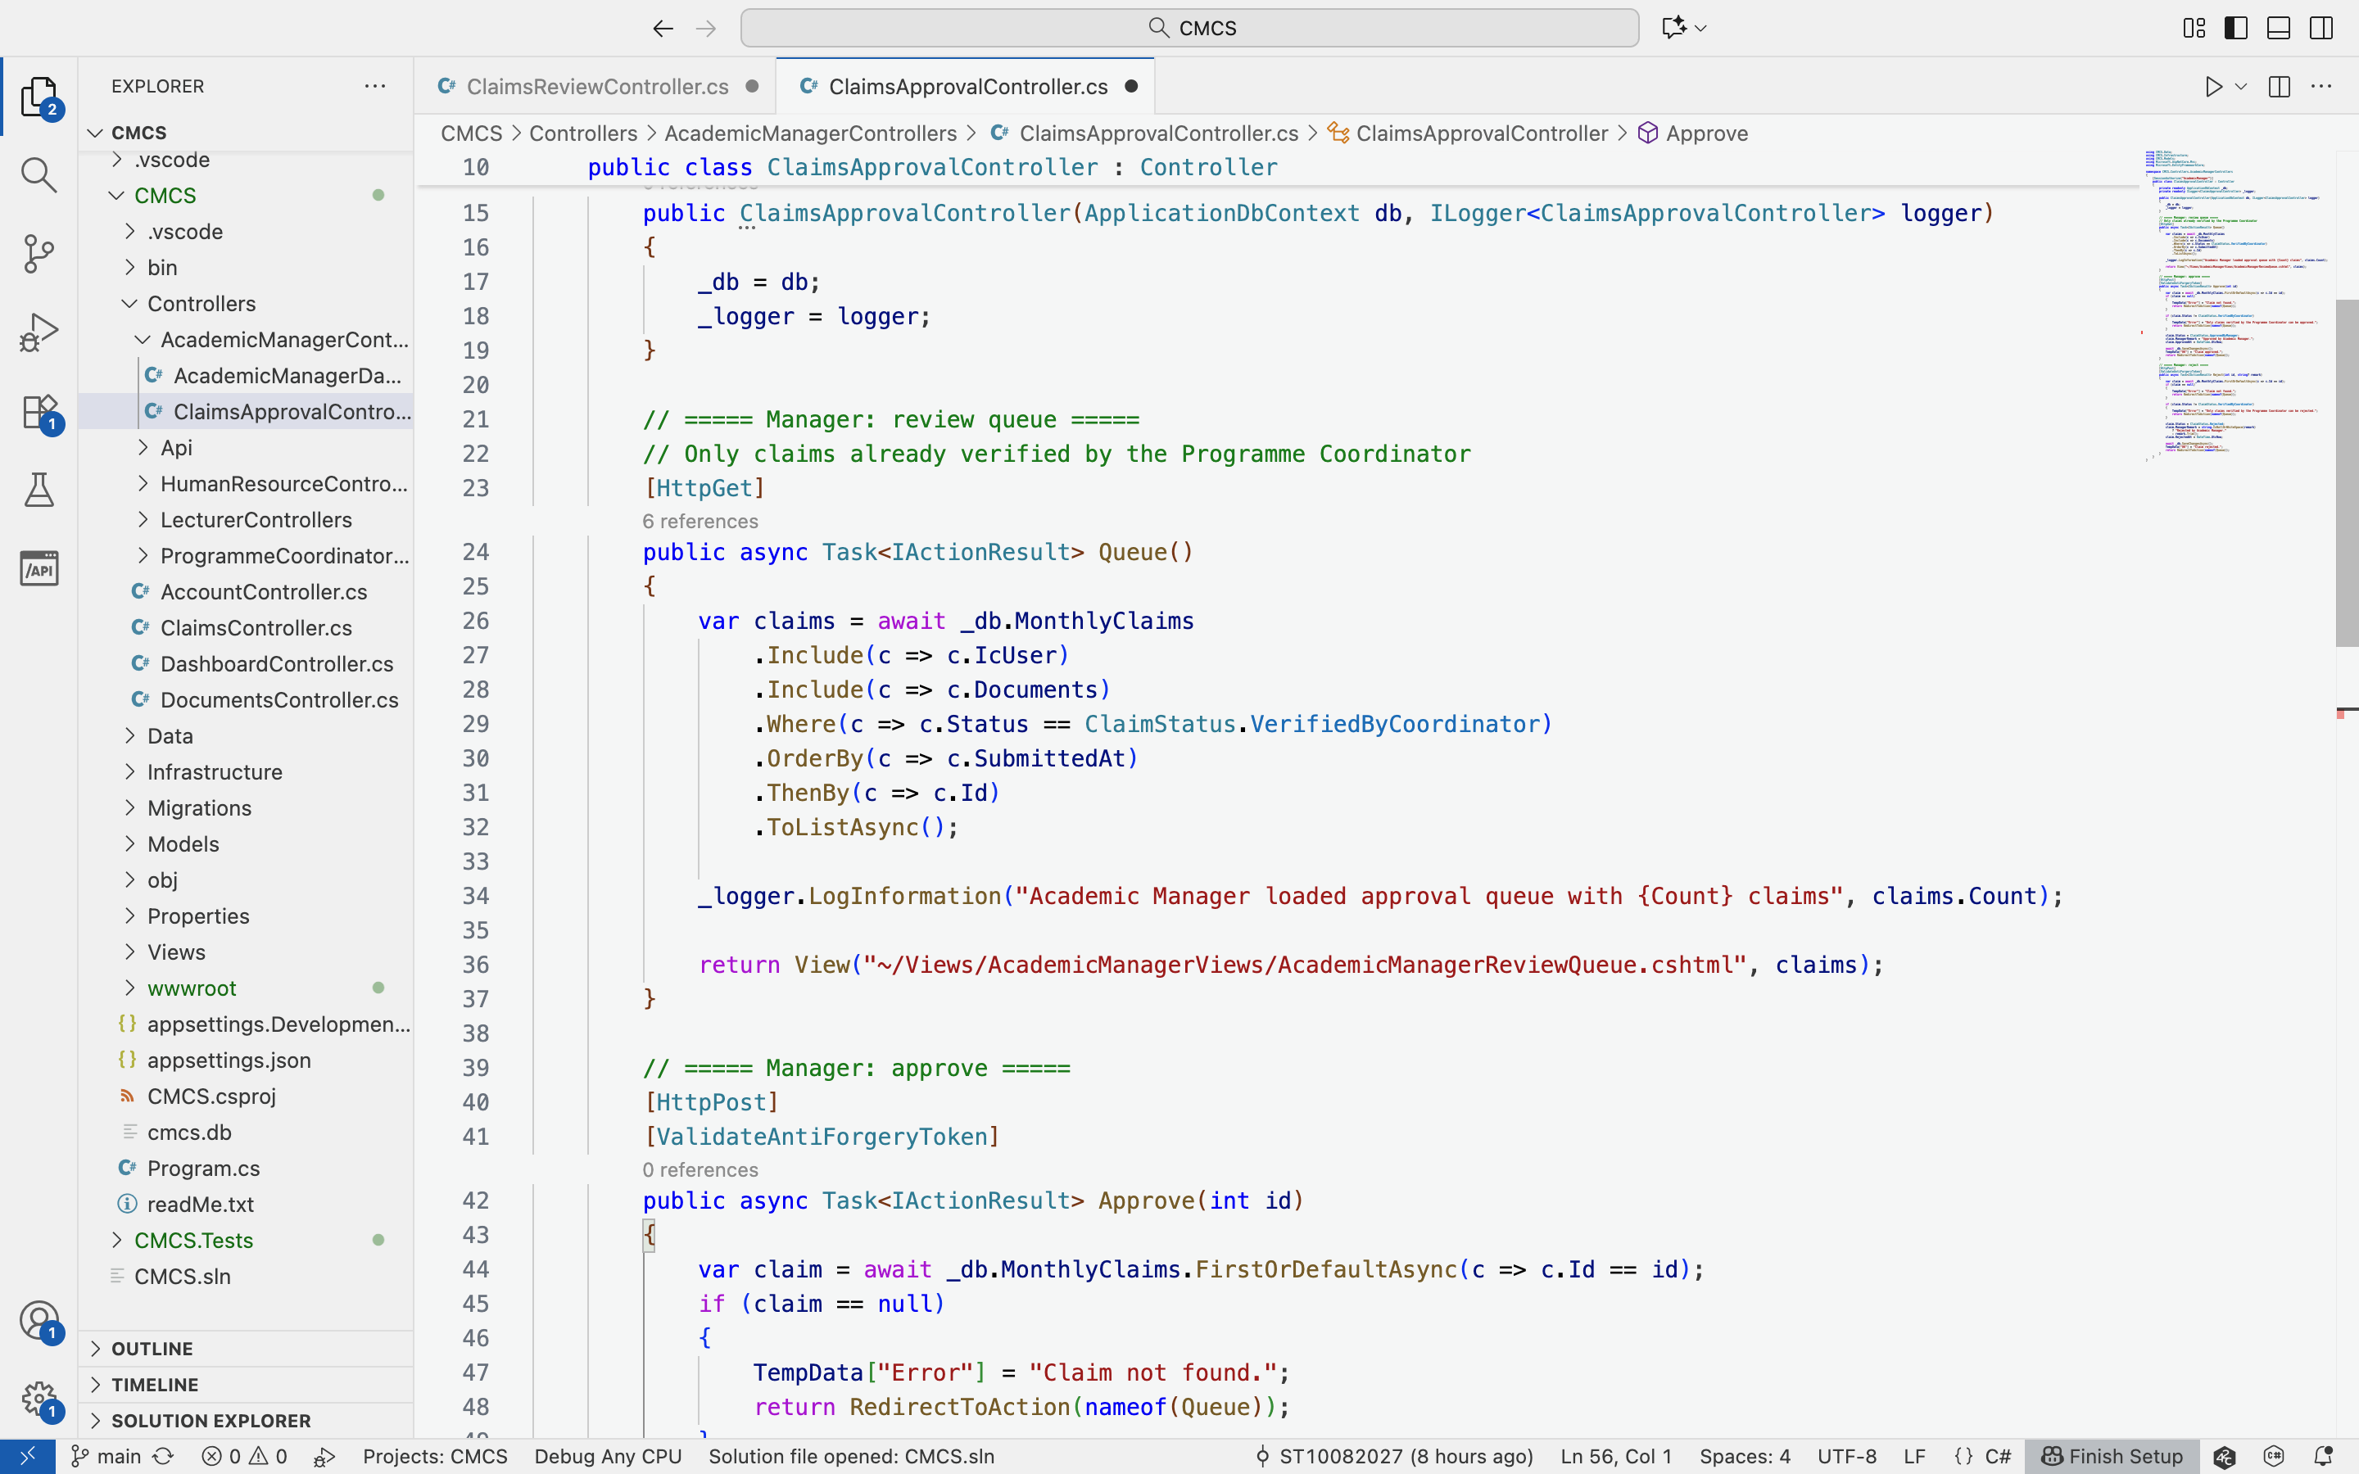
Academic manager: review queue Code

Slide 26
Human resources
Create and manage all users.
Assign lecturer hourly payment rates.
Generate detailed claims reporting.
Oversee system-wide administrative operations.
Finalize approved claims for payment.

Slide 27
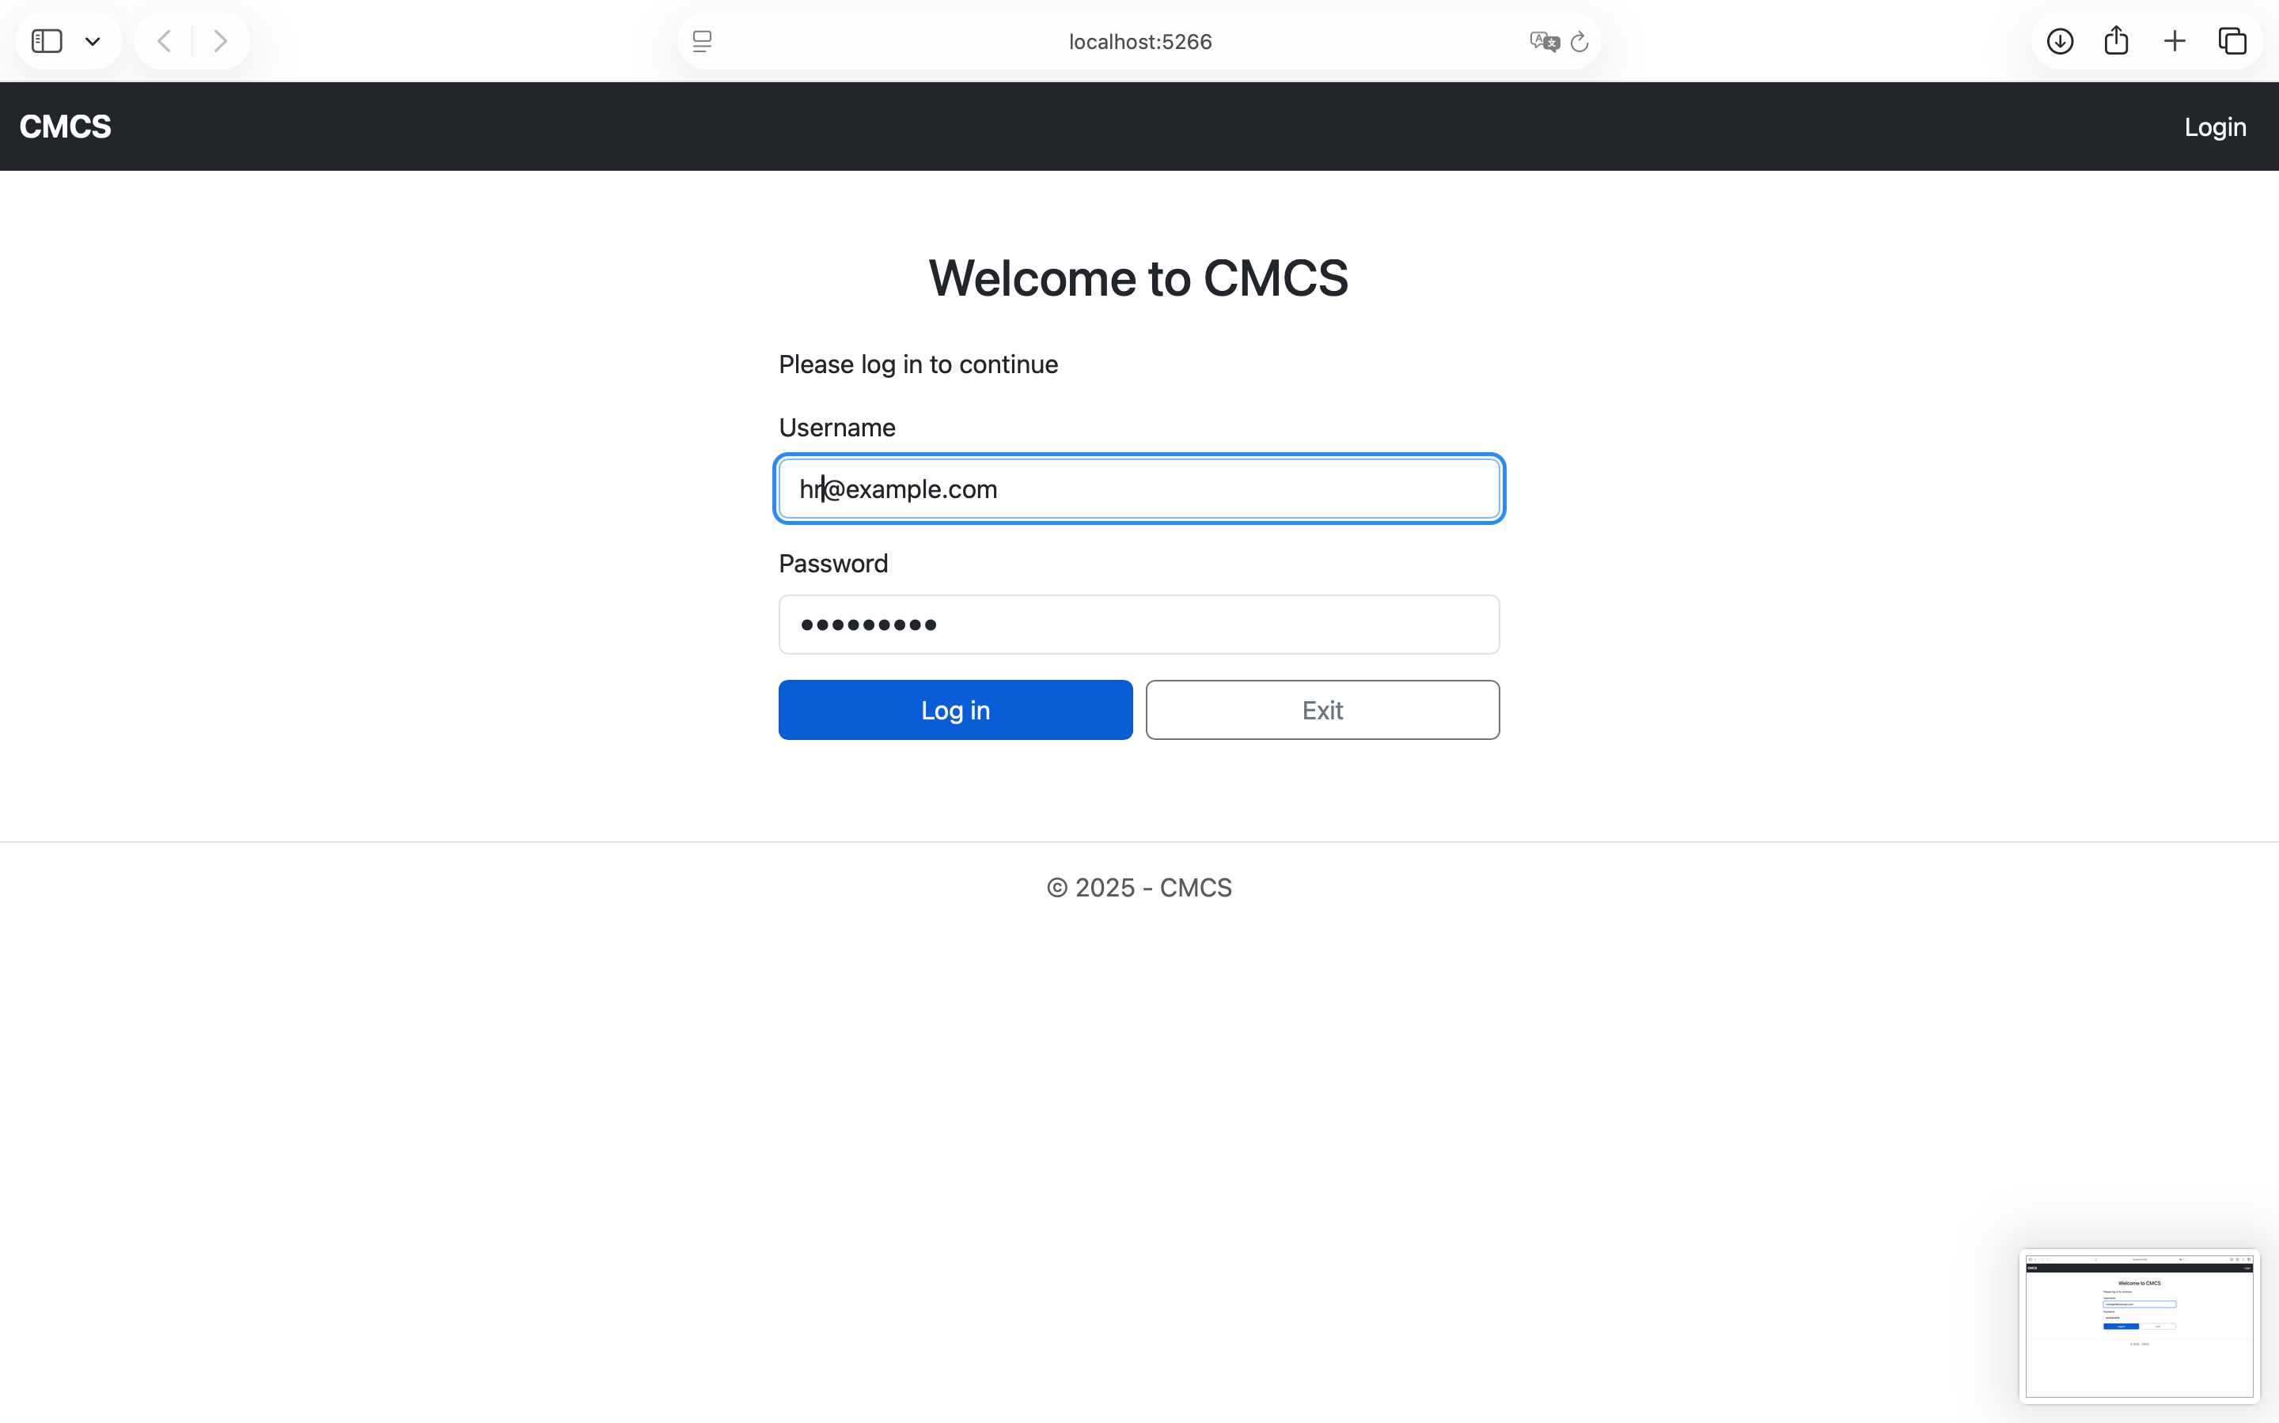
human resources: Log in

Slide 28
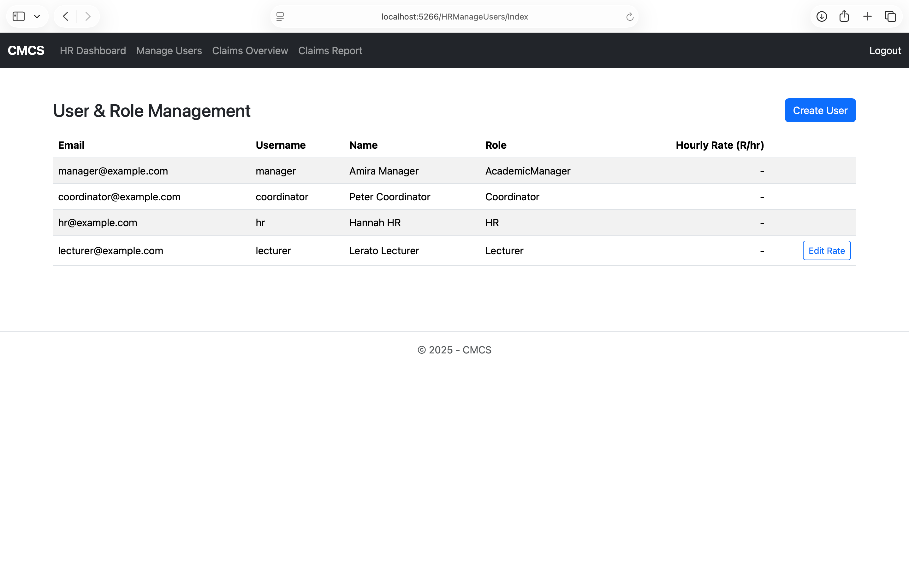
Human resources: dashboard
Manages all user accounts

Slide 29
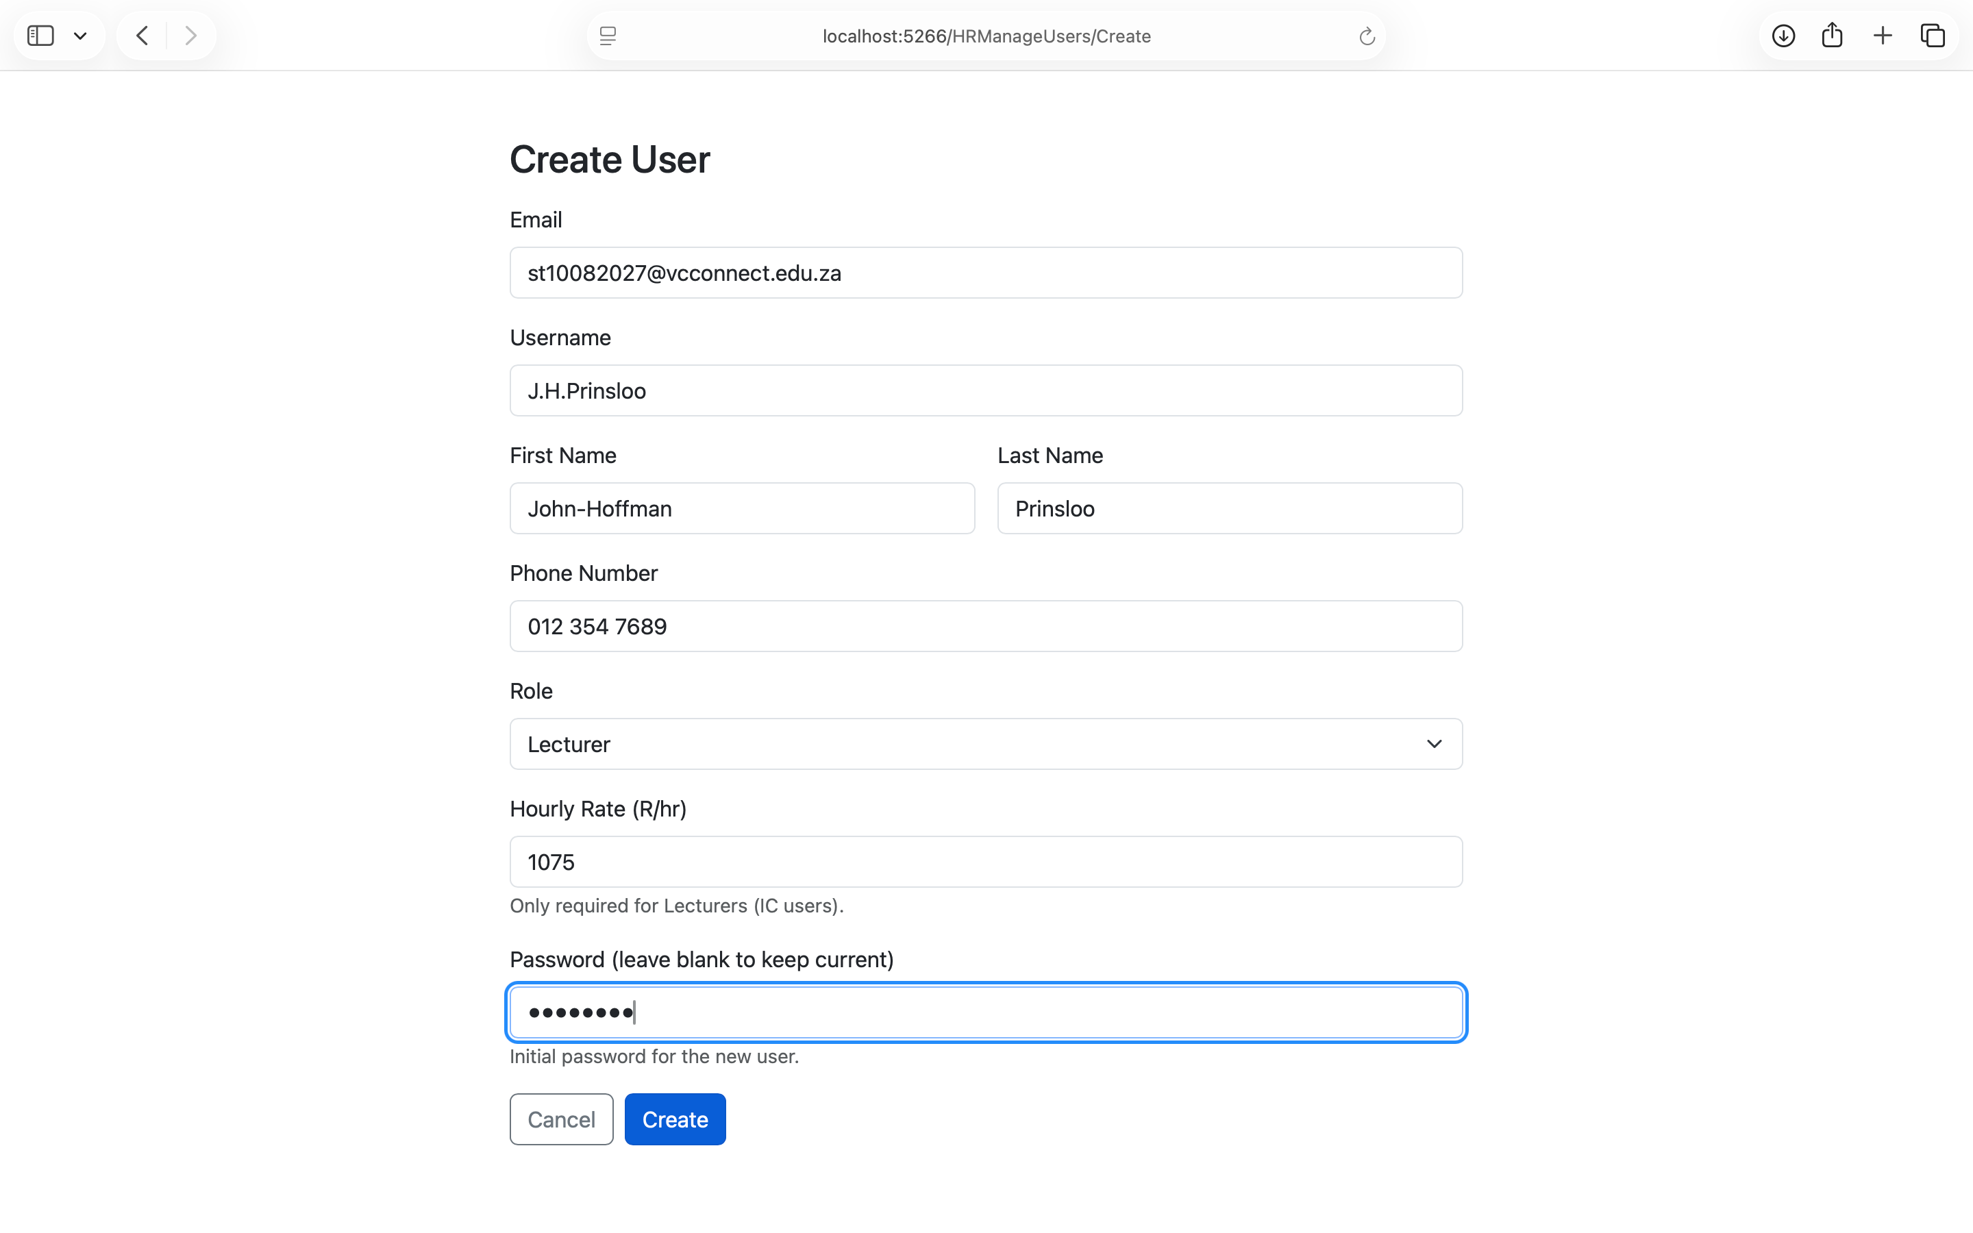
Human resources: create user
Acts as the super user / system admin

Slide 30
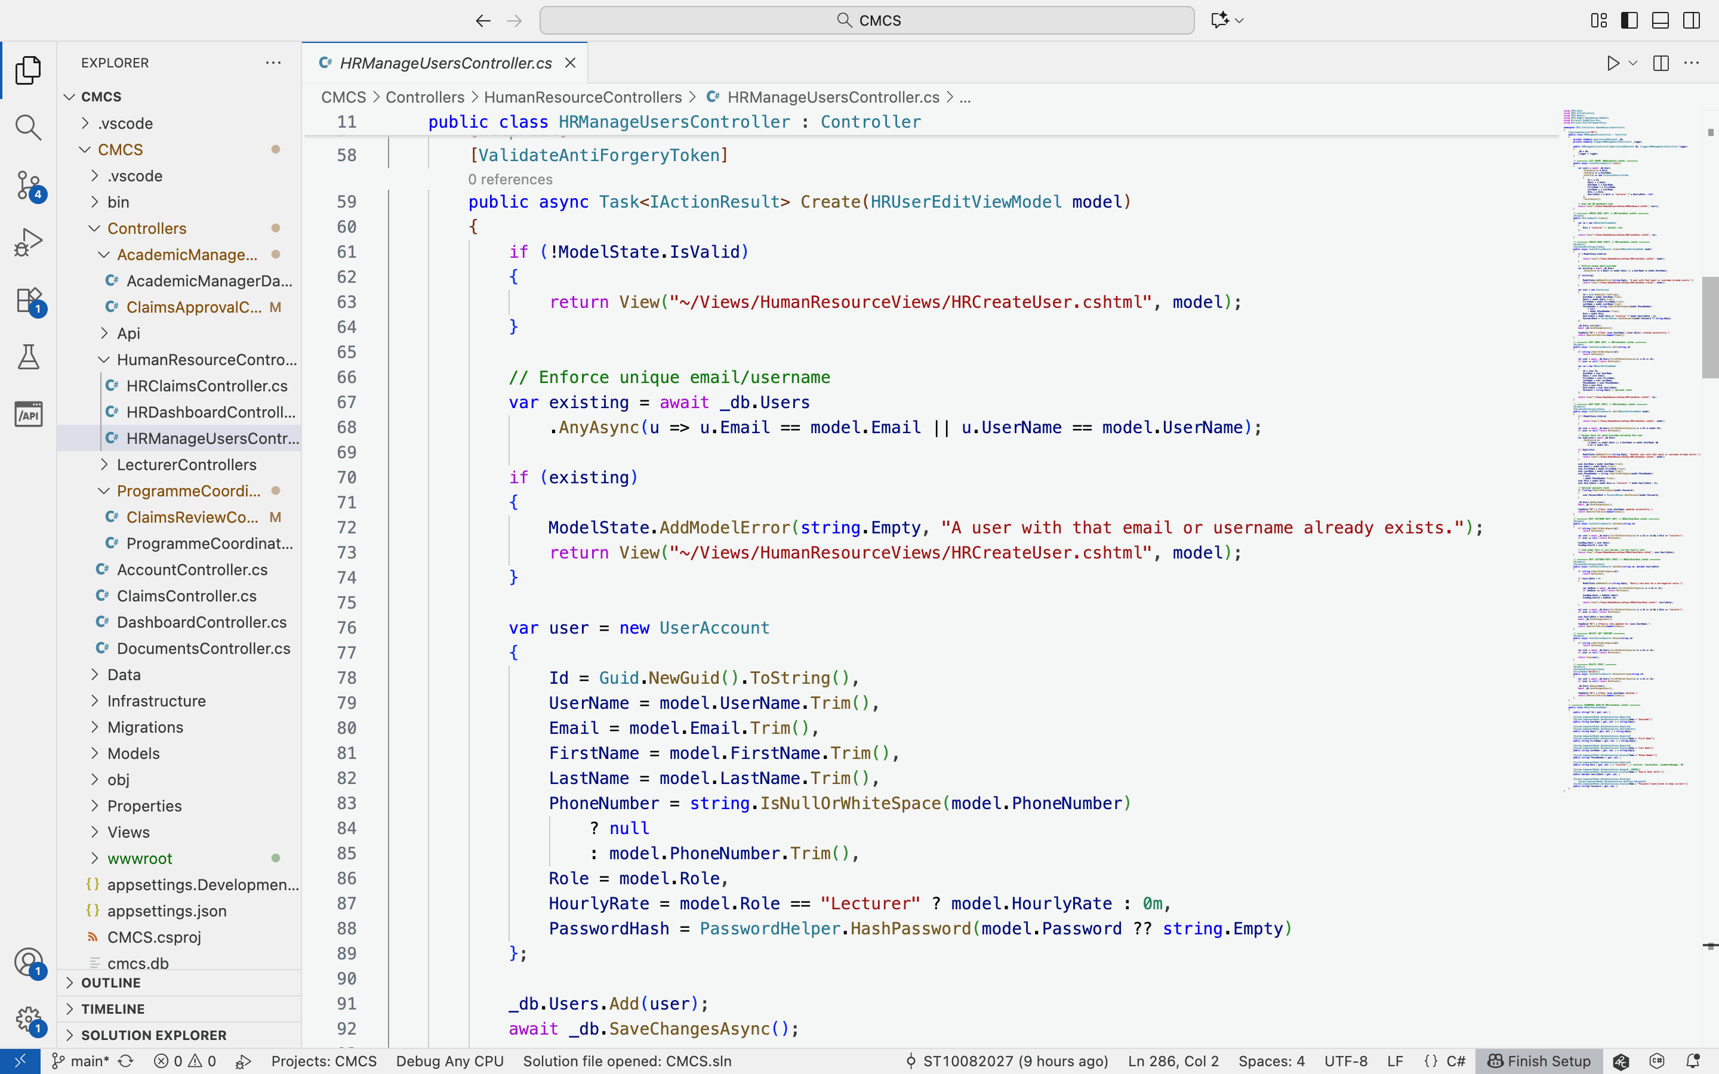
Human resources: create user code
HR creates user accounts, assigns roles and lecturer hourly rates

Slide 31
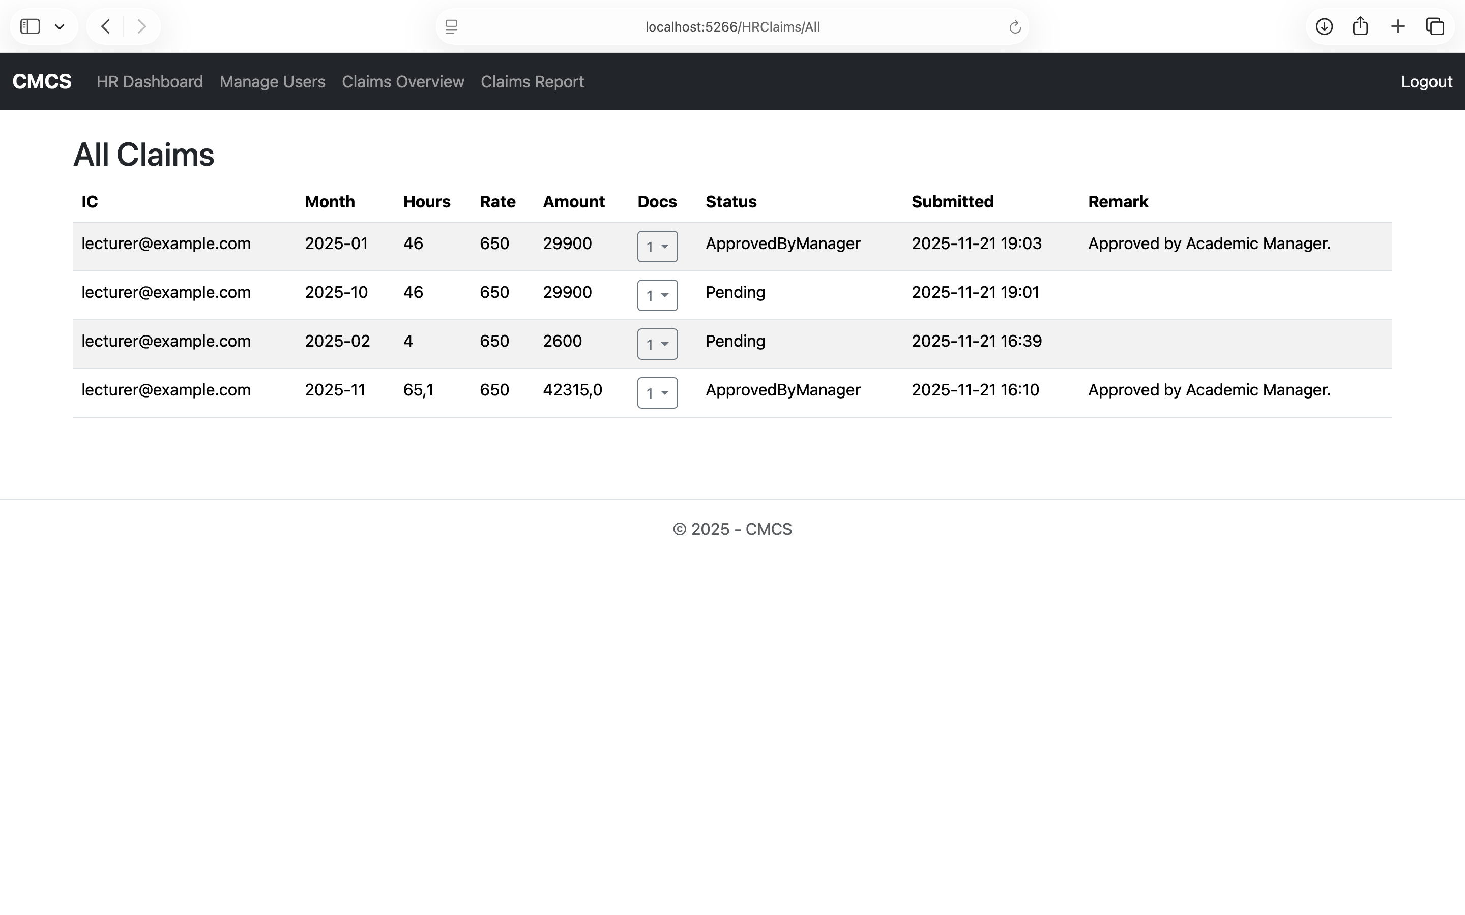
Human resources: all claims
Finalises approved claims before payment processing

Slide 32
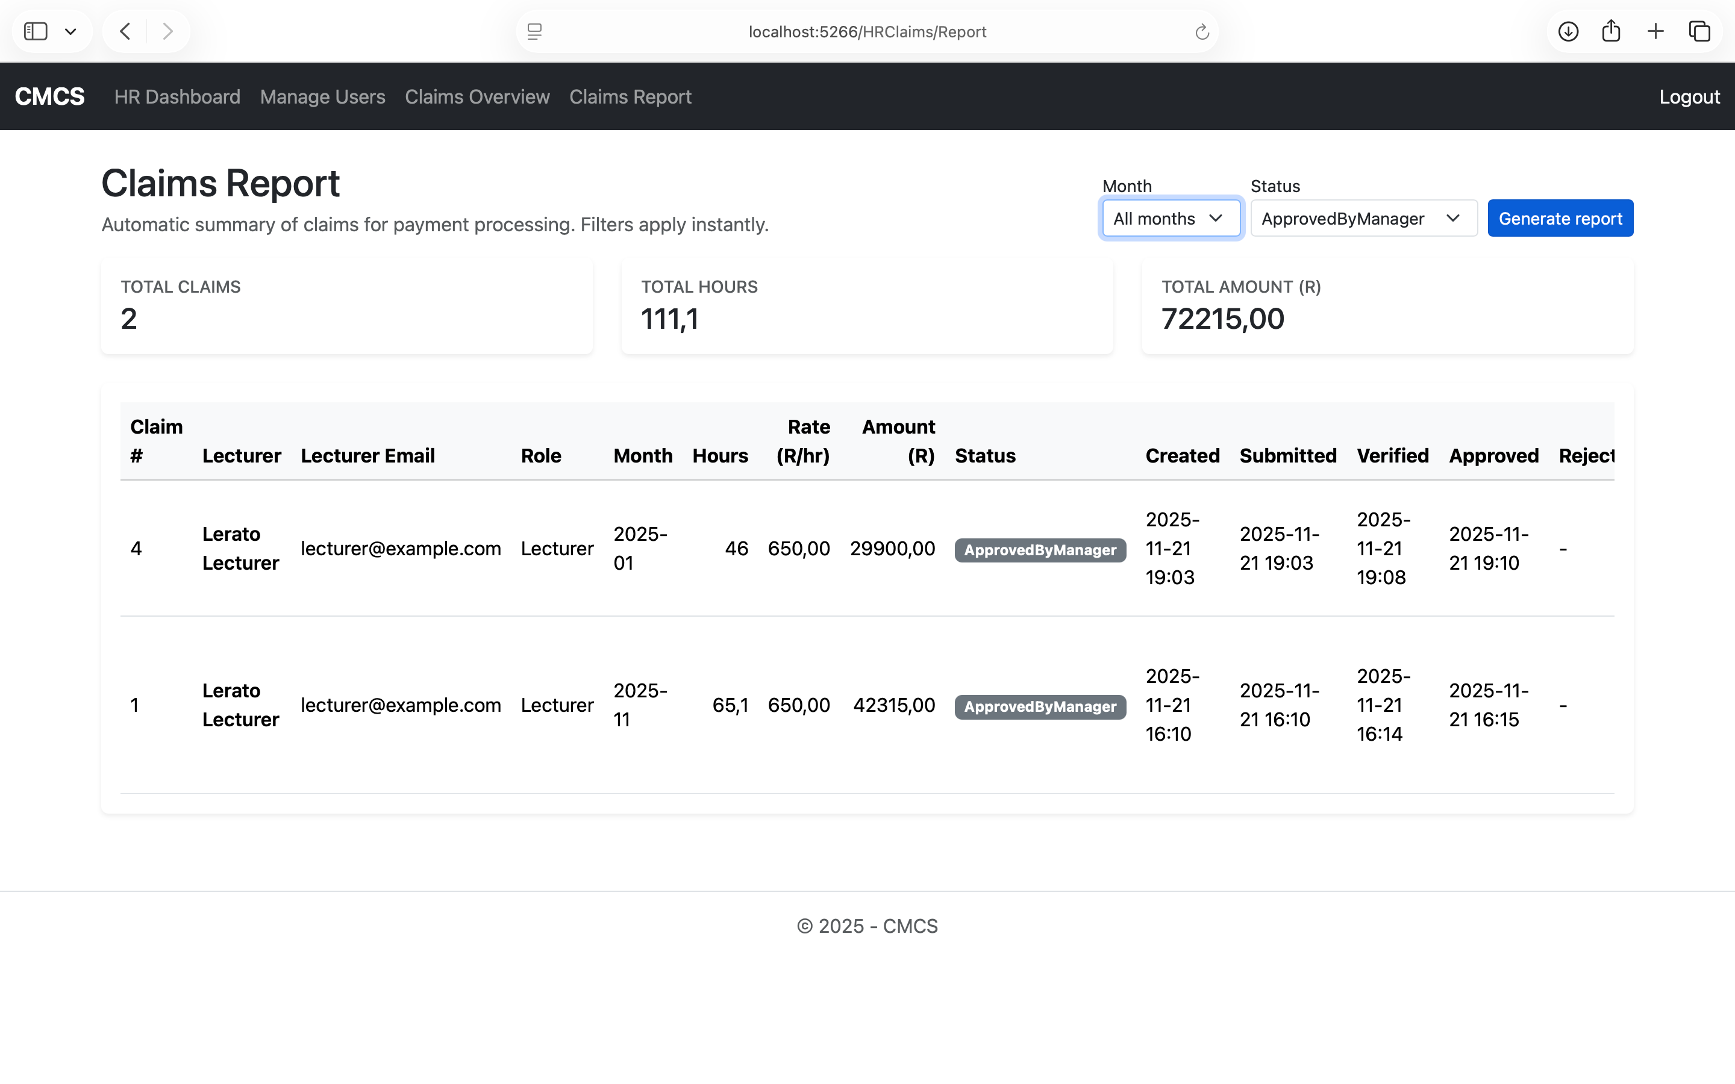
Human resources: claims report
Generates invoices or reports for approved claims

Slide 33
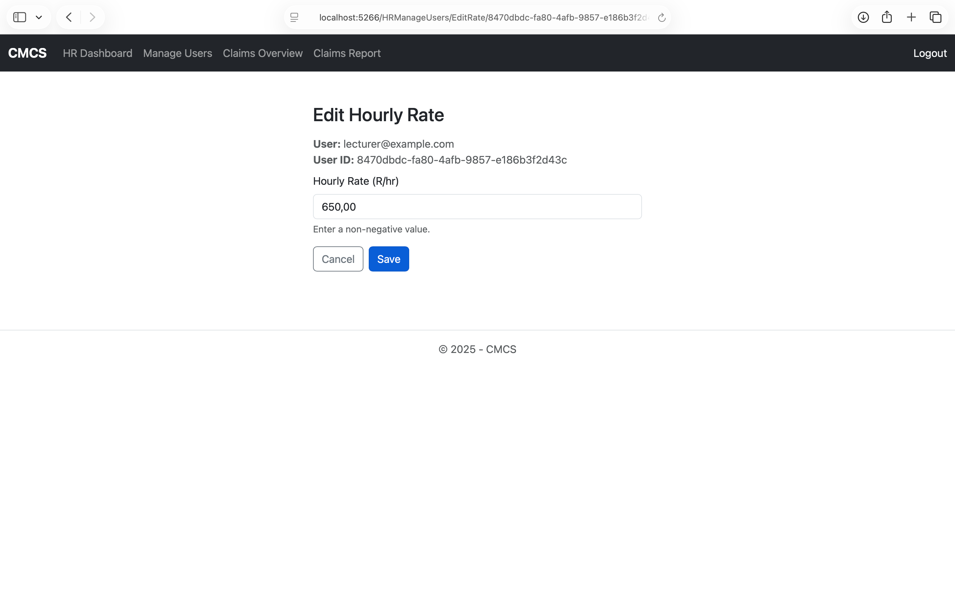
Human resources: edit hourly rate
Do I need to explain?

Slide 34
Thank you for your time

